Slide 1


Tudo sobre compartilhamento externo no Microsoft 365
@sarabarbosa

Slide 2


Slide 3


Slide 4
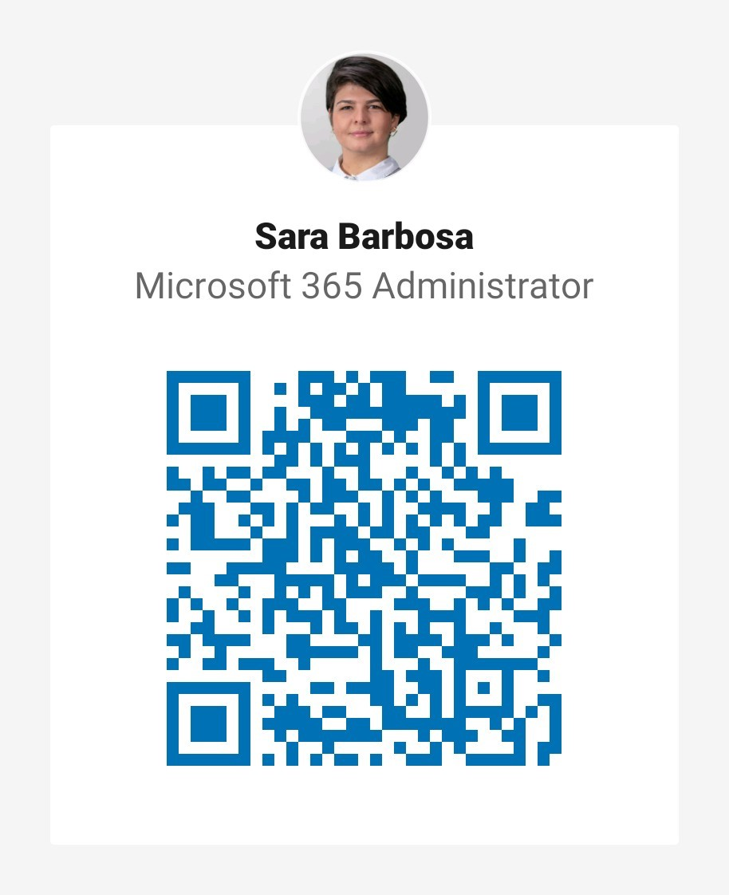


Brazilian, living in Berlin.
Love beers, cold weather and beers…
MCSA, Office 365 MVP since 2011.
Microsoft 365 Administrator @ Schindler (Berlin)
You can find me:
www.sarabarbosa.net
<- LinkedIn
Twitter - >

Slide 5
Agenda
Sharing overview
What’s new for users – Ignite 2019
Management overview
What’s new for admins – Ignite 2019

Slide 6

Sharing Overview

Slide 7
Scenarios

Slide 8
Simple external sharing I’m sending sales materials to a customer
Share it with whomever you want
Sales materials
Sales materials
Make it easy for them
Don’t make them sign-in
Don’t make them create an account
Let them forward it to whoever they want

Slide 9
“Anyone” links Works for anyone that has the link

Slide 10

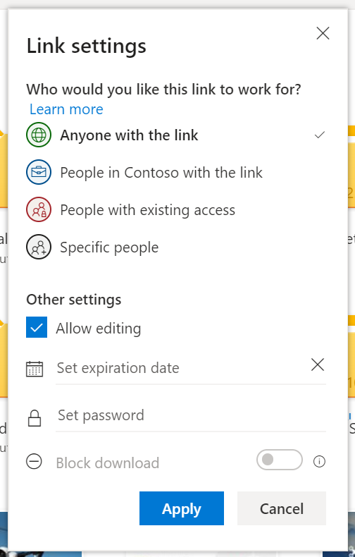
“Anyone” links
The easiest way to share files and folders
Recipients decide who else gets access
Guaranteed to open for anyone who receives it, on any device
Share with anyone easily via email, chat, social, etc. No frustrating errors or sign-in/up

Slide 11
Contoso
Shareable link
…lets you forward to anyone as needed
…like an attachment without encryption
Has access because they have the link
Does not have access,
gets access if they get the link

Slide 12

What’s difference between anyone link and an attachment to an email?

Slide 13
“People in my organization” links

Slide 14

Moment...

Slide 15
“People in my organization” links are for…
Internal users = employees!
Onmicrosoft.com, contoso.com... Etc.
B2B Accounts / Guests aren‘t people in my organization.

Slide 16
Contoso
Does not have access, cannot get access through the link
Internal-only shareable link
(only people in Contoso with the link)
…lets you forward within your company only
…like a magic attachment that blocks external users
Has access because they have the link
Does not have access,
gets access if they get the link

Slide 17

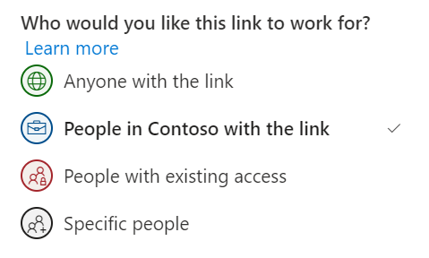
“People in my organization” links
Allows recipients to forward within your organization
Blocks external people from accessing

Slide 18
“People with access” links

Slide 19
“Specific people” links

Slide 20
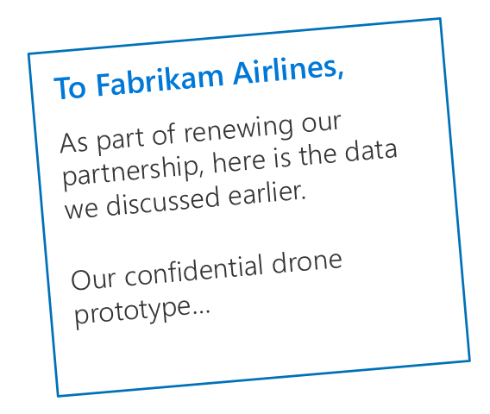
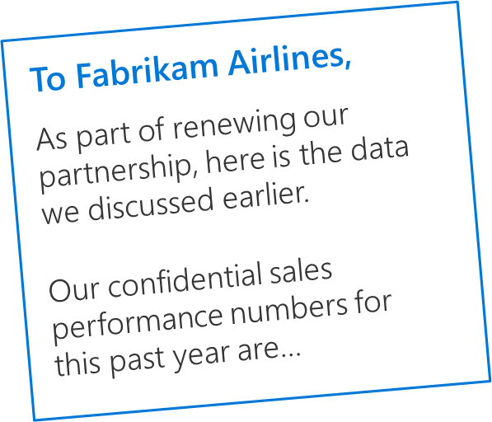
Secure external sharing I want an external partner to review my secret document
To Fabrikam Airlines,
As part of renewing our partnership, here is the data we discussed earlier.
Our confidential drone prototype…
For your eyes only, Larry
Make it easy for them
Minimize effort to open the link
Keep it secure
Don’t let them forward it to anyone else

Slide 21
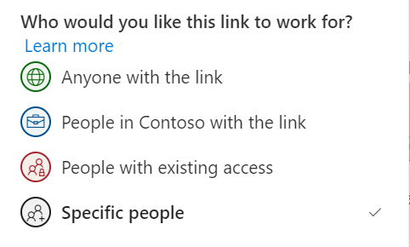
“Specific people” links
Only work for the people you specify
Can specify internal or external users
Email verification for external users happens via one-time passcode
External recipients never have to sign up for a Microsoft account

Slide 22
Same experience everywhere

Slide 23
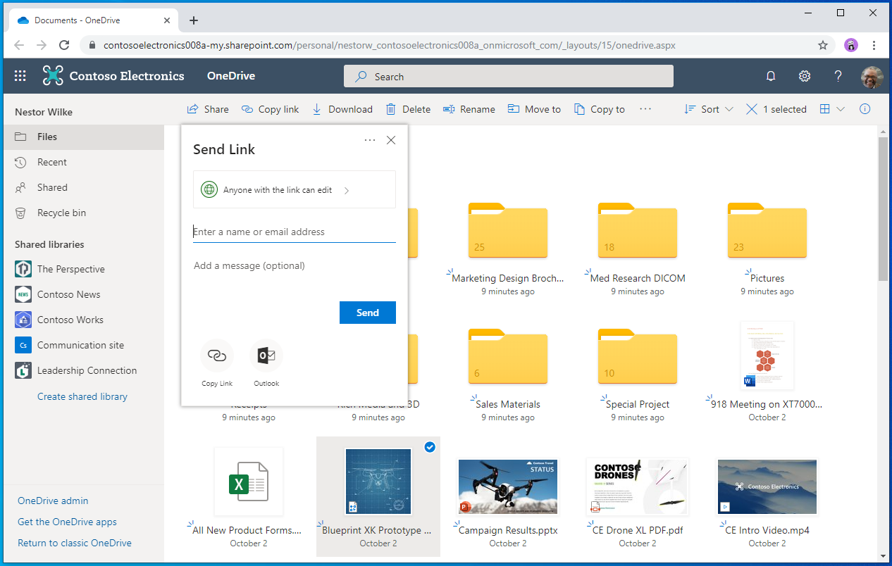
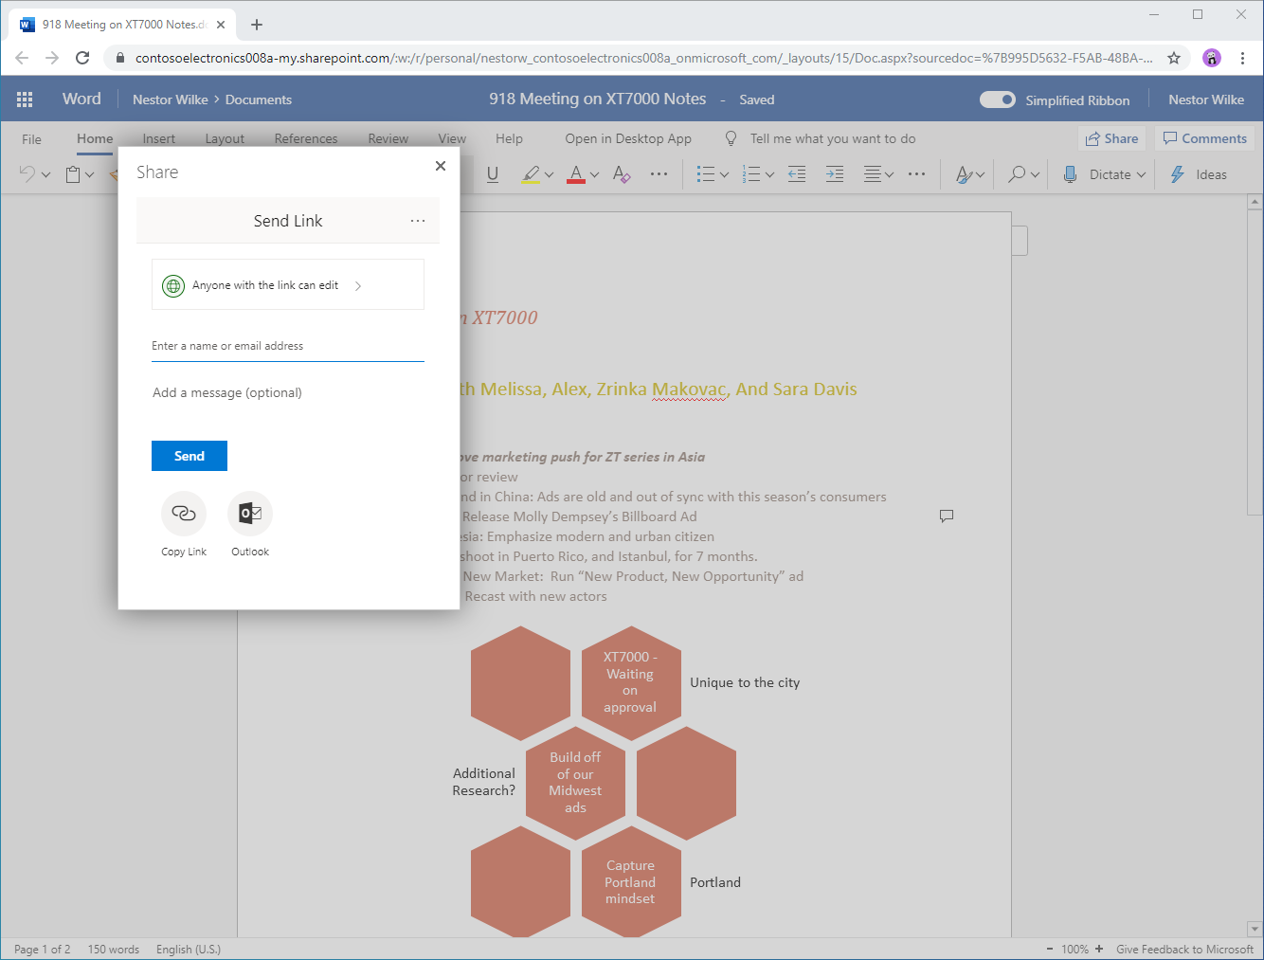
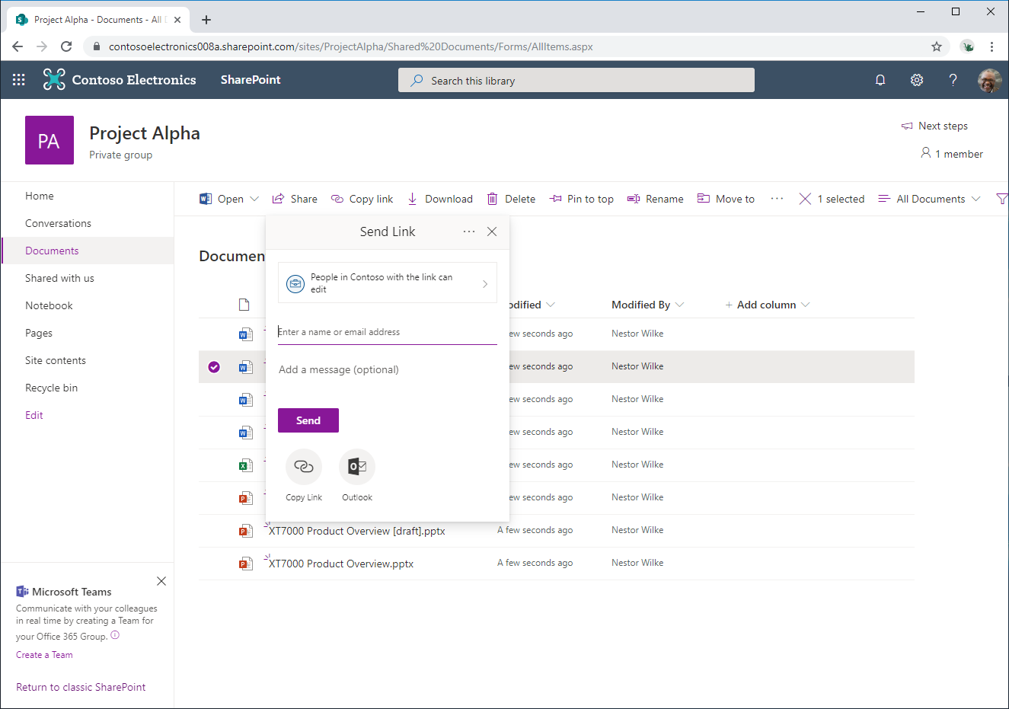
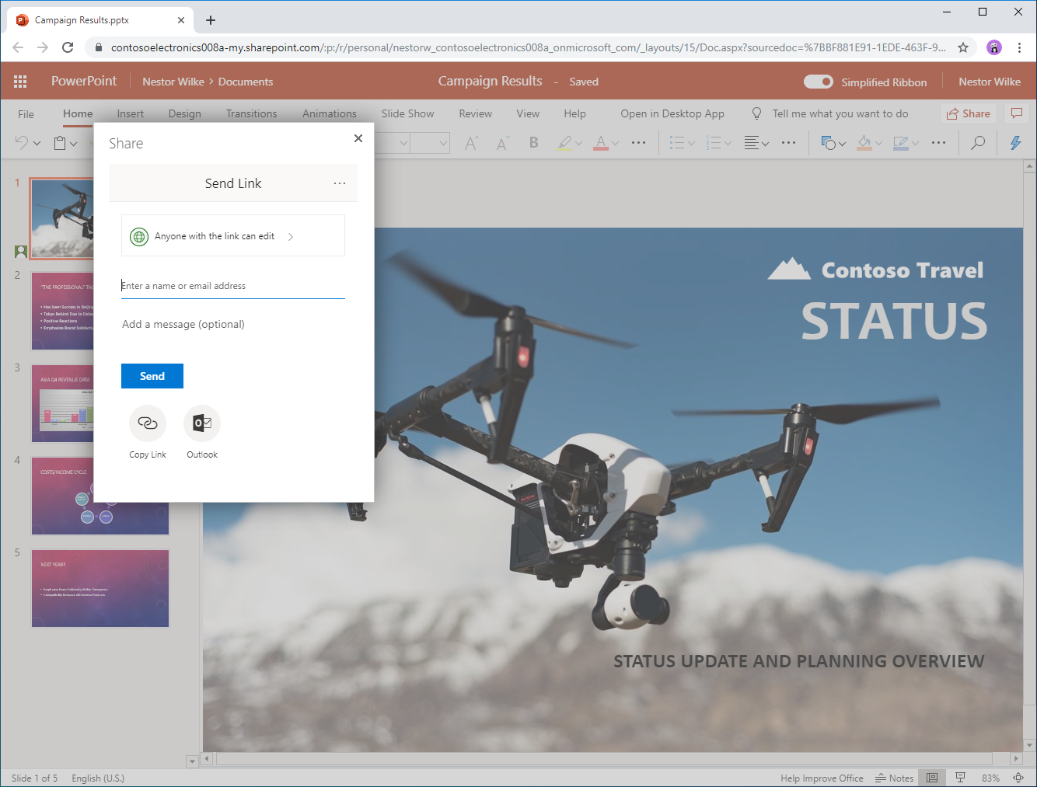
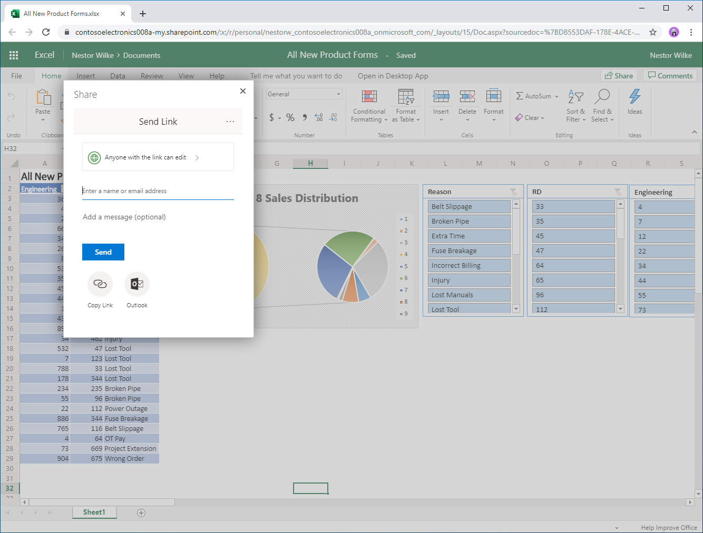
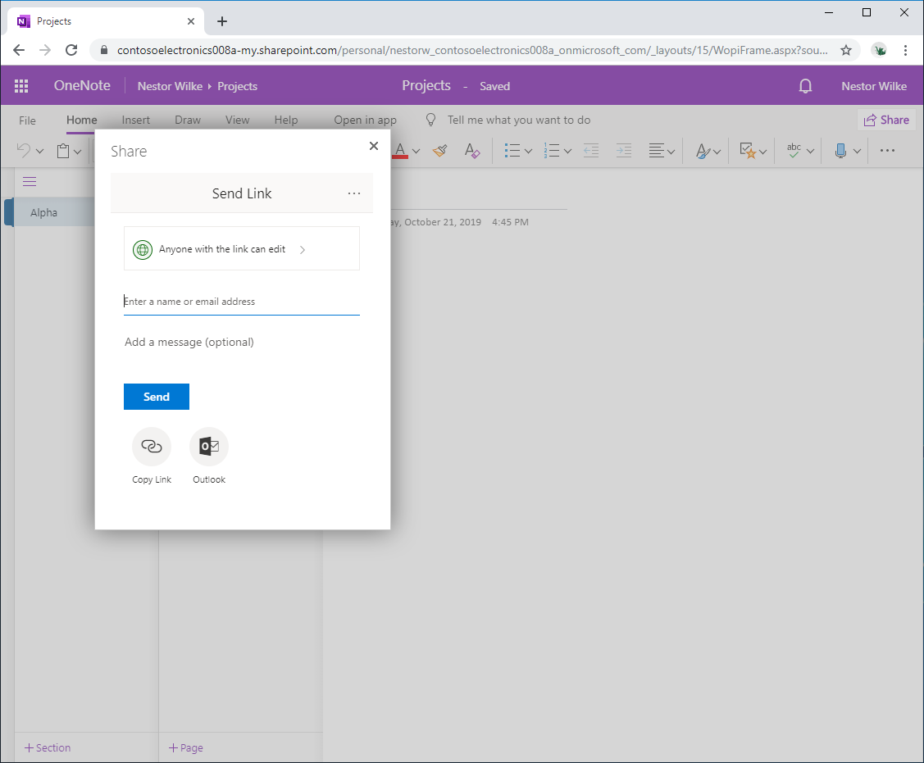

Slide 25
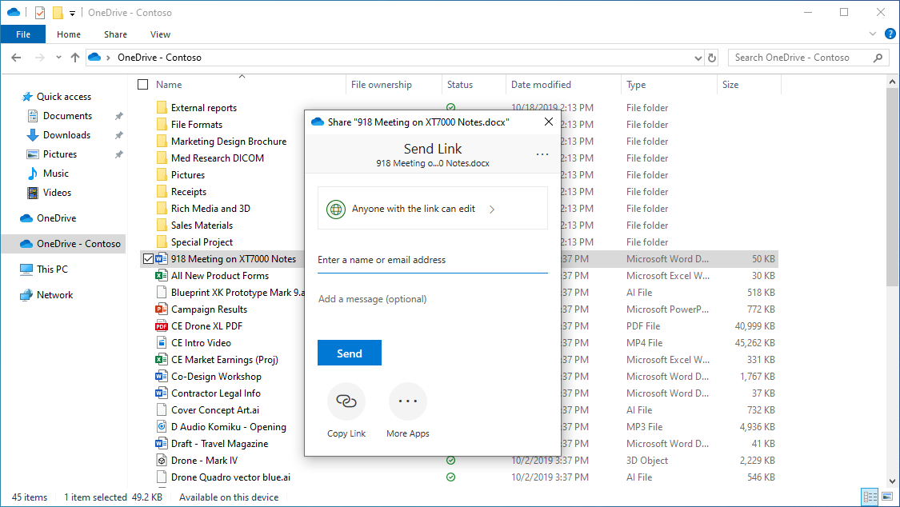
Finder

Slide 26
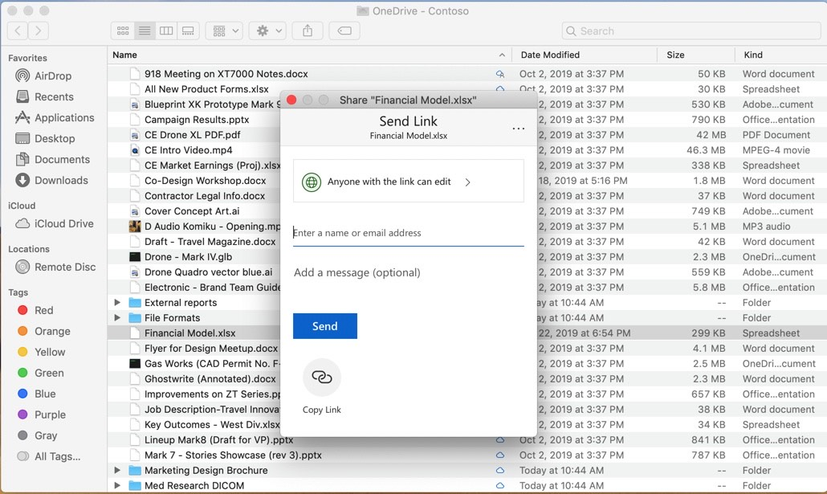

Slide 27
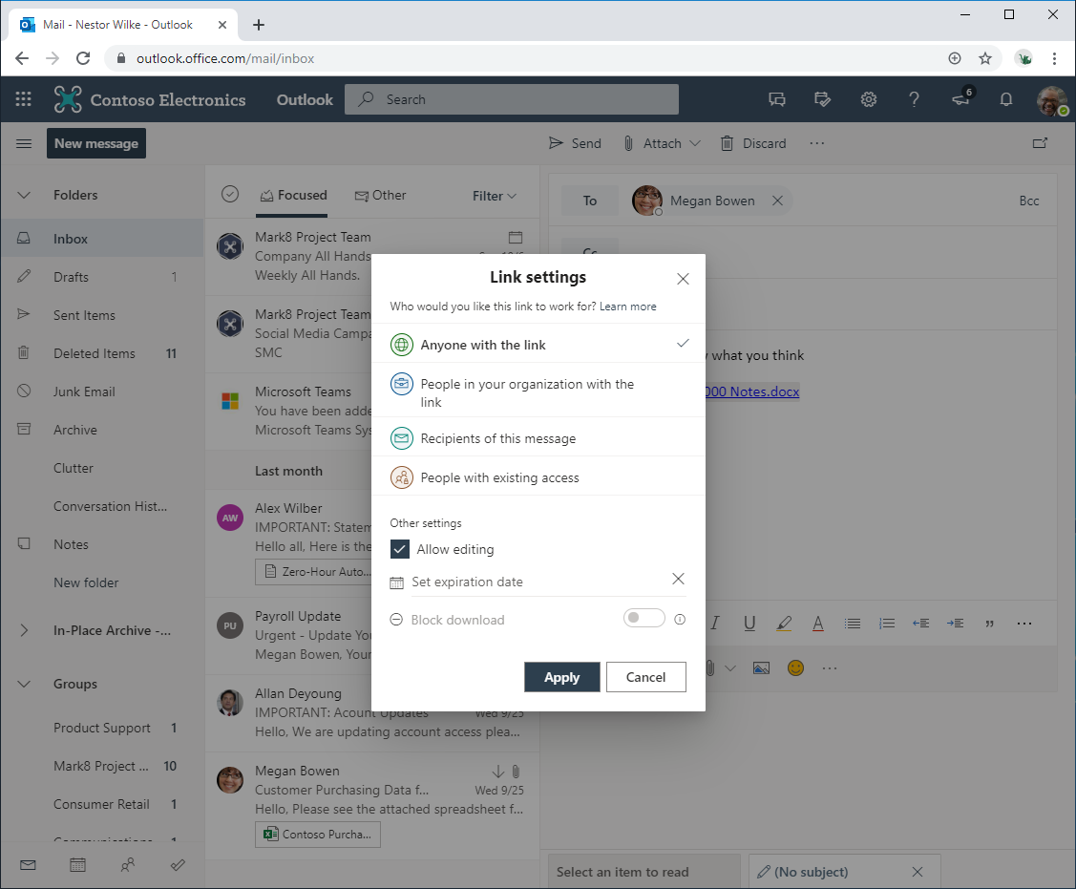

Slide 28
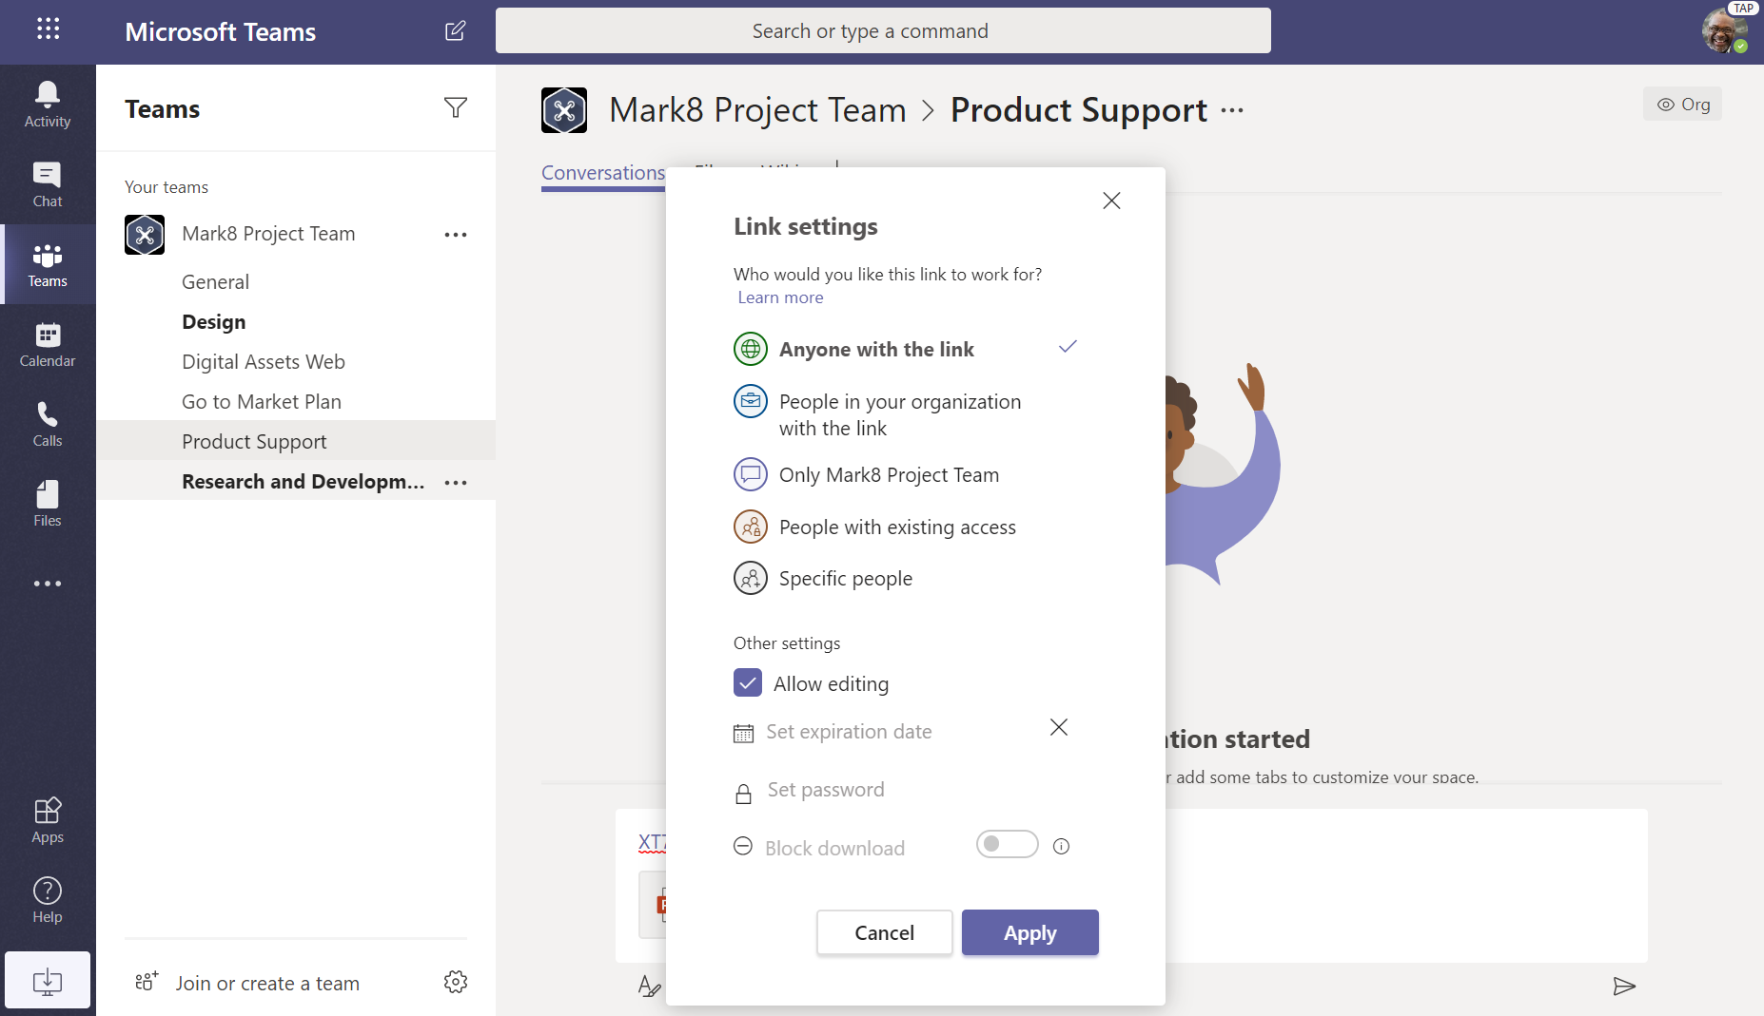

Slide 31
















Share throughout Microsoft 365
OneDrive
Word
Excel
PowerPoint
OneNote
Teams
Outlook
SharePoint
Same sharing experience. Same sharing capabilities.
Web
Desktop
Mobile

Slide 32
Share throughout Microsoft 365
OneDrive
Word
Excel
PowerPoint
OneNote
Teams
Outlook
SharePoint
Same sharing experience. Same sharing capabilities.
Web
Desktop
Mobile

Slide 33
Agenda
Sharing overview
What’s new for users
Management overview
What’s new for admins

Slide 34

What’s new for users

Slide 35
Sharing integration in Outlook #demo

Slide 36
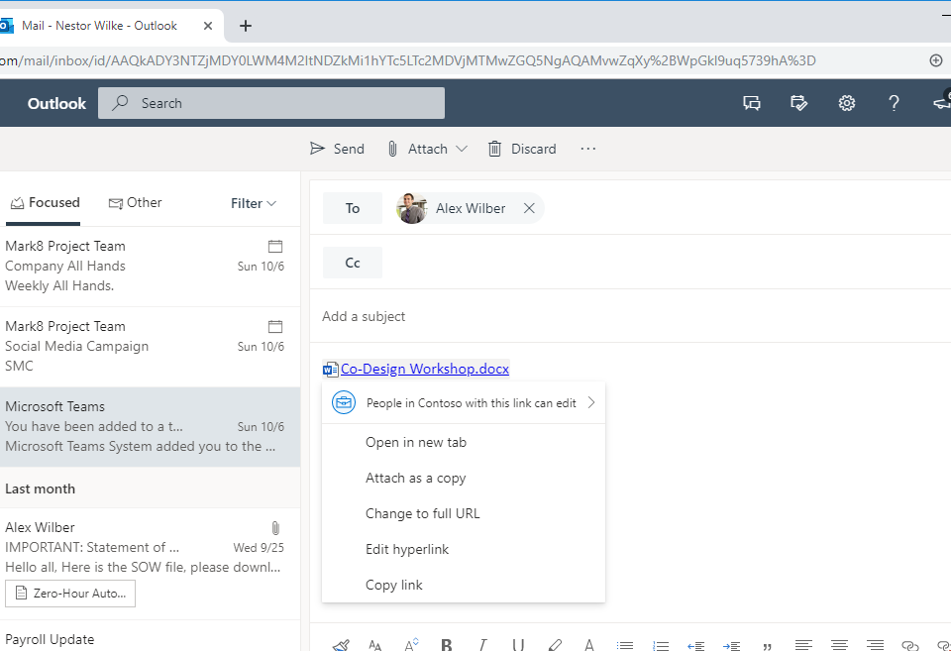
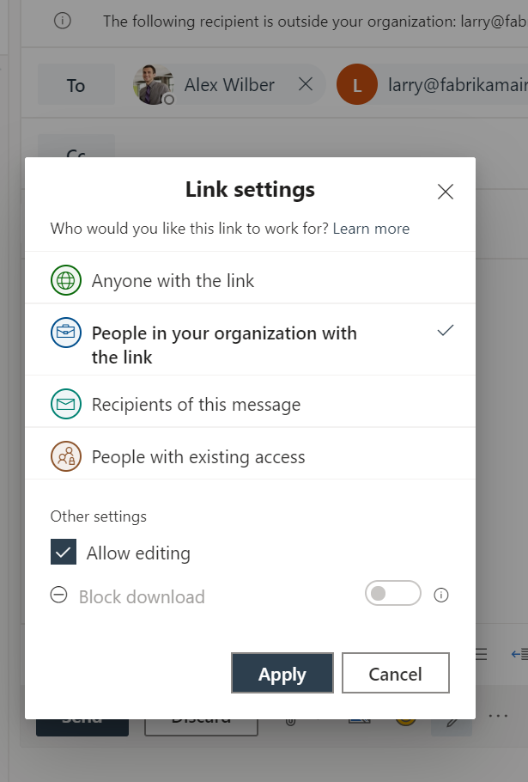

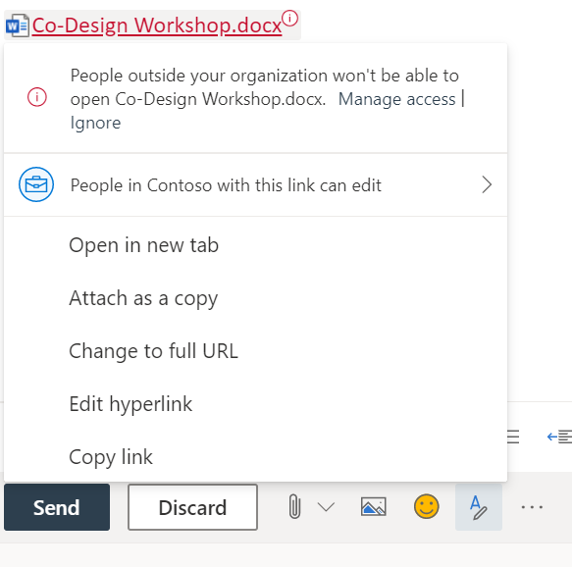
NEW! Sharing integration in Outlook
Complete set of sharing features in Outlook
Protection against sending links that won’t work for all recipients
Easily create links that only work for people in the email thread
Follows all admin settings and policies you’ve configured
Available now in Outlook on the web

Slide 37
Sharing integration in Microsoft Teams

Slide 38
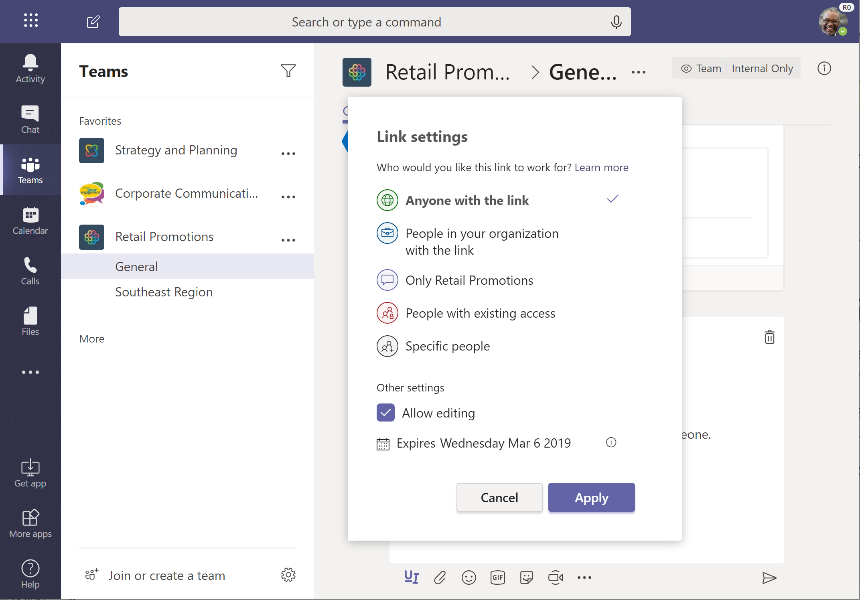
NEW! Sharing integration in Microsoft Teams
Complete set of sharing features in Teams
Share files without creating unintended copies
Easily create links that only work for people in your team
Follows all admin settings and policies you’ve configured
Coming this year

Slide 39
Sharing links that block download

Slide 40
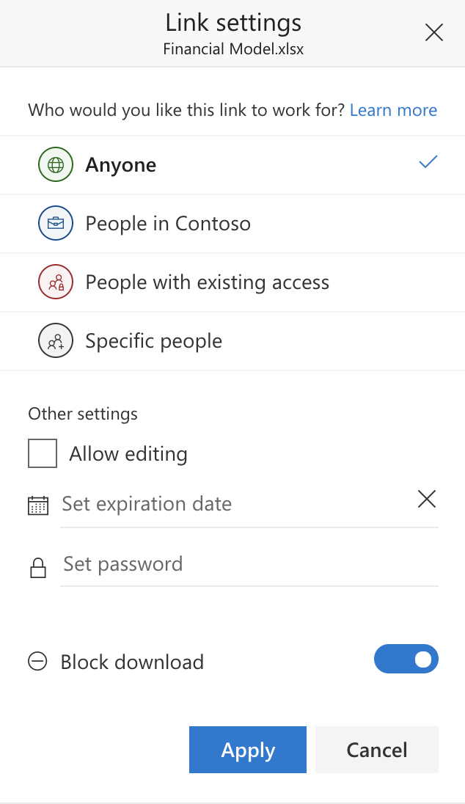
NEW! Block downloads
Keep your documents in the cloud
Avoid out-of-date copies
Maintain access control
Available for view-only links
Now supports “specific people” links
Available now for Office files
Coming early 2020 for PDF & more
Notes:
Douglas

Slide 41
Use Case – Request Files

Slide 42
Book publisher
Process to publish a book with collaboration, productivity and being manageable
- Design the cover;
- Writer;
- Reviewer;
- Editorial chief;
- Printer;
…more

Slide 43
Request files using OneDrive for Business (OOTB - DEMO)

Slide 44
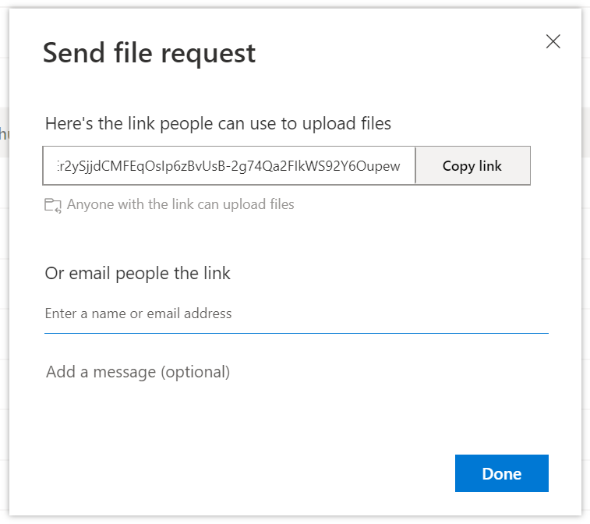
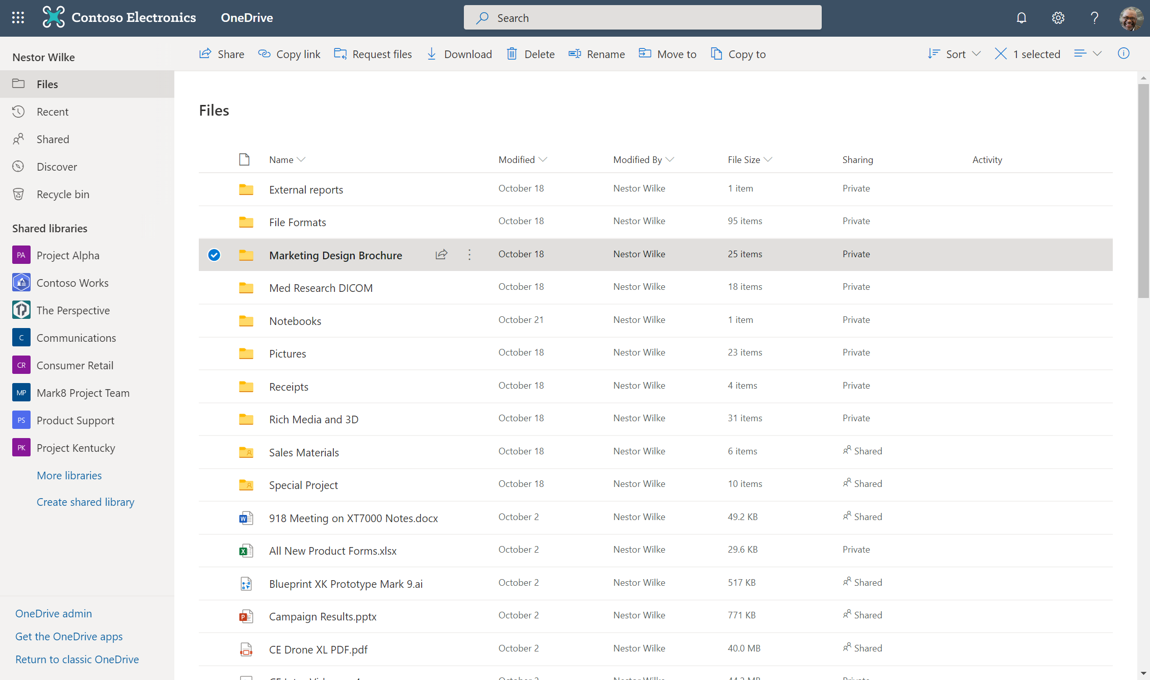
Pick a folder and request files…

Slide 45
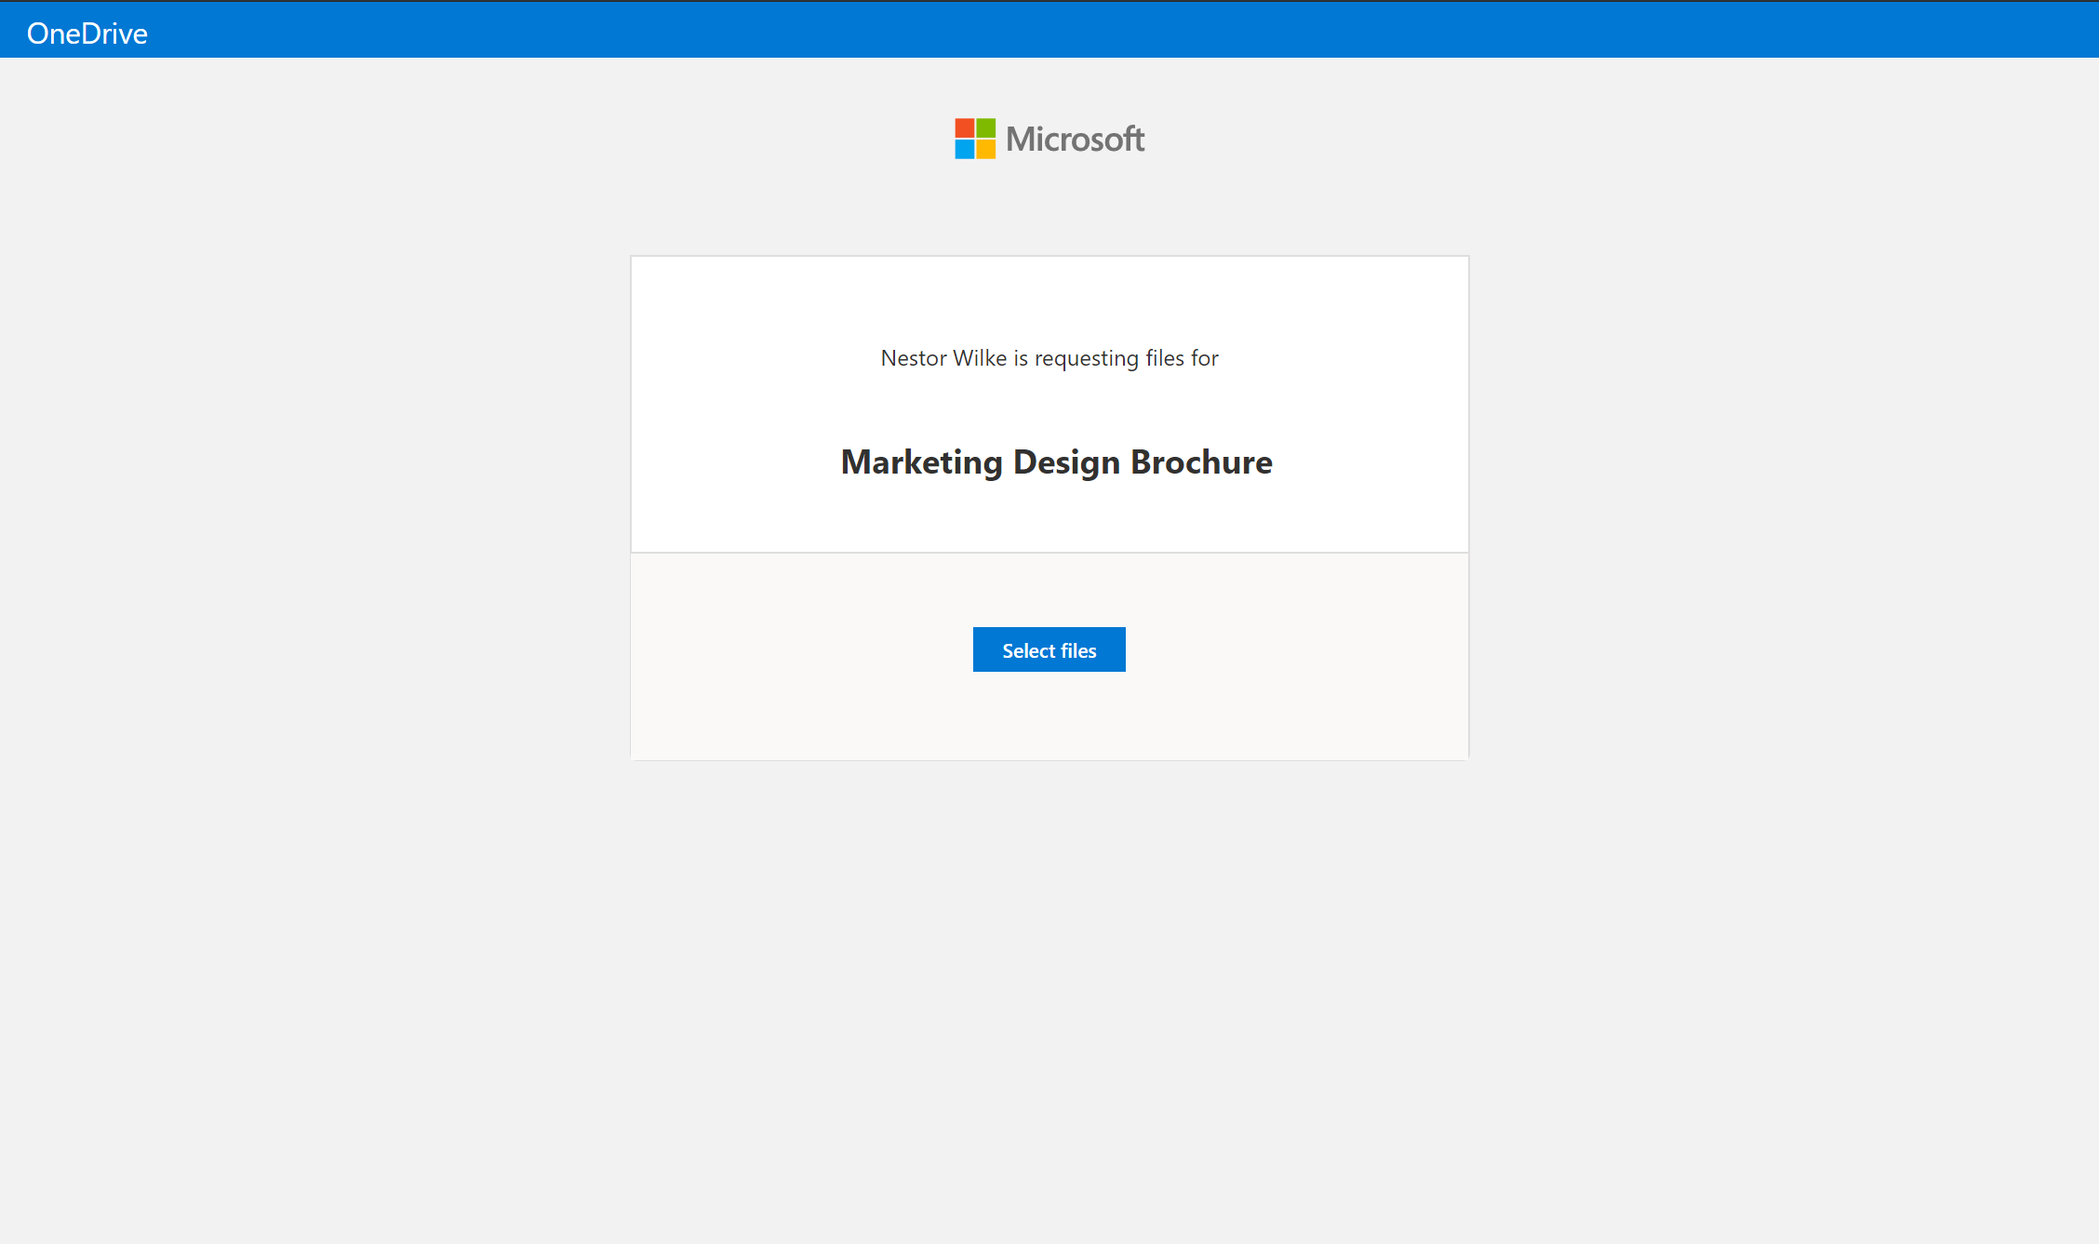
…with a link that works for Anyone that gets it.

Slide 46
…with a link that works for Anyone that gets it.

Slide 47
…with a link that works for Anyone that gets it.

Slide 48
…with a link that works for Anyone that gets it.

Slide 49
…with a link that works for Anyone that gets it.
Streamlined experience that lets people upload without viewing folder contents…

Slide 50
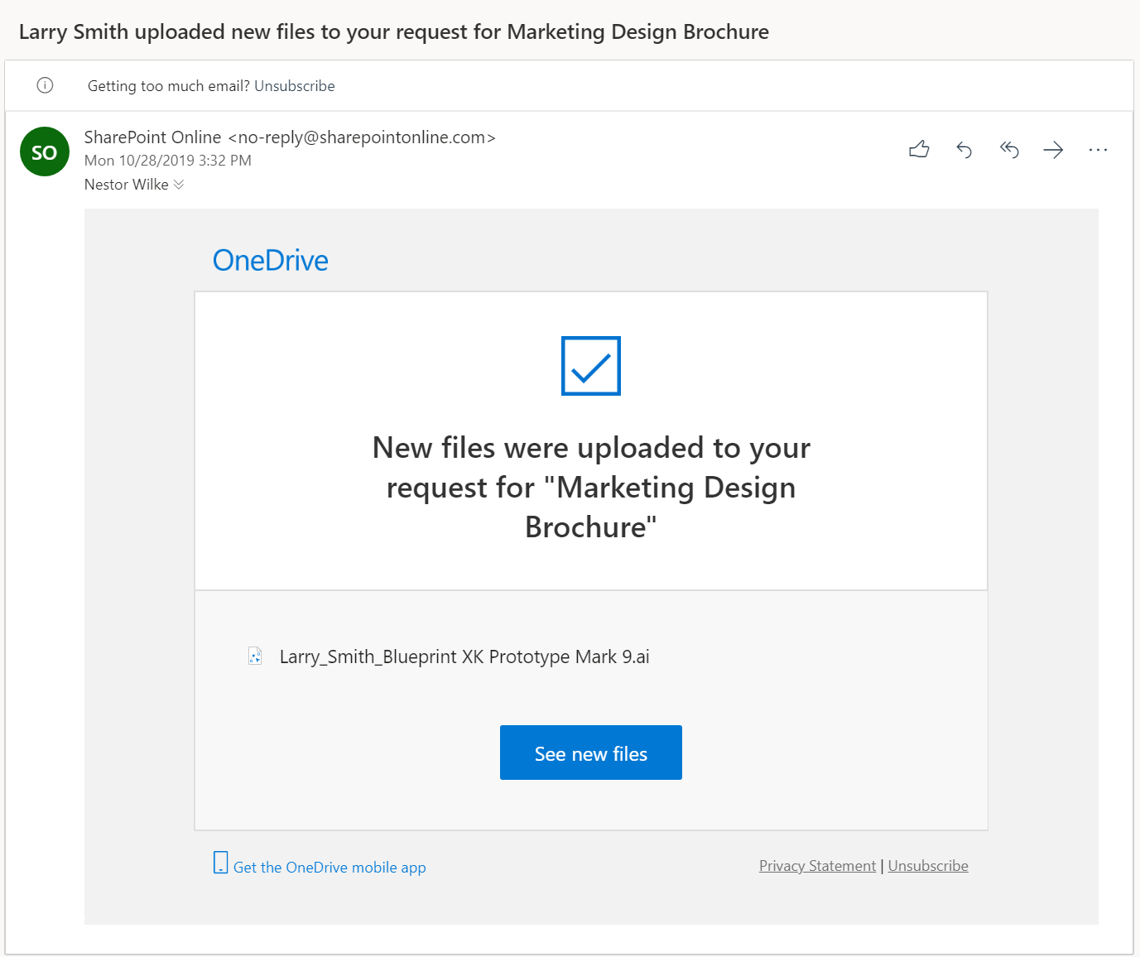
…that works for Anyone with the link…
Streamlined experience that lets people upload without viewing folder contents…

Slide 51
NEW! Request Files
Let people upload to a folder without letting them see what’s in the folder
Works for internal and external users
Available
…that works for Anyone with the link…
…with a streamlined experience that lets people upload without viewing folder contents…
…and lets you know once files have bene submitted

Slide 52
Get link to PowerPoint slide

Slide 53
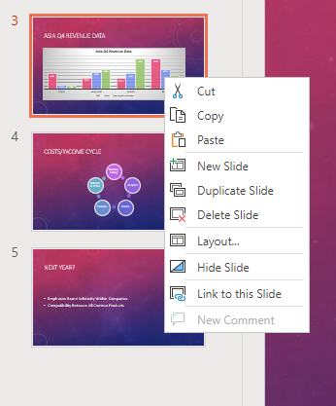
NEW! Get link to PowerPoint slide
Get a link that takes recipients directly to the slide you need them to look at
Continues to work even as slides get moved around
Same common experience that respects IT policies and allows users to change link permissions/settings
Available now on PowerPoint on the web

Slide 54
Link from browser address bar

Slide 55
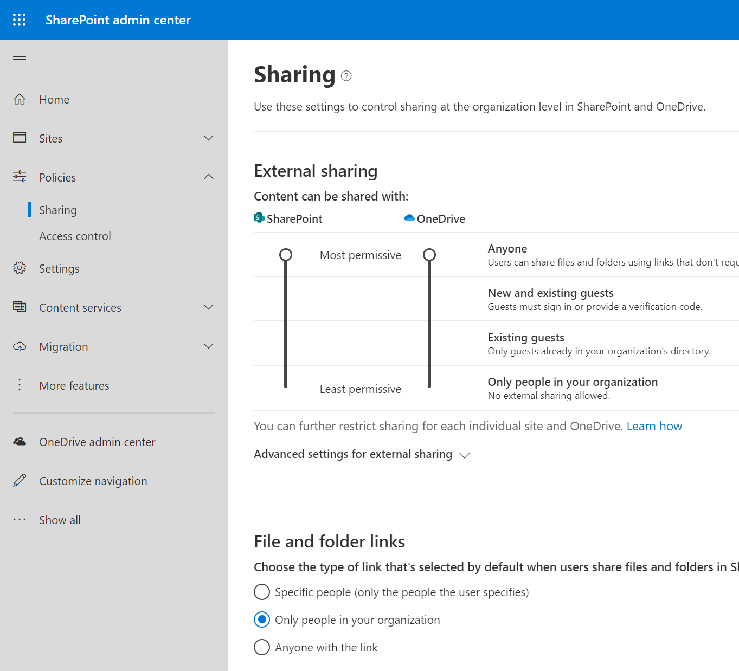
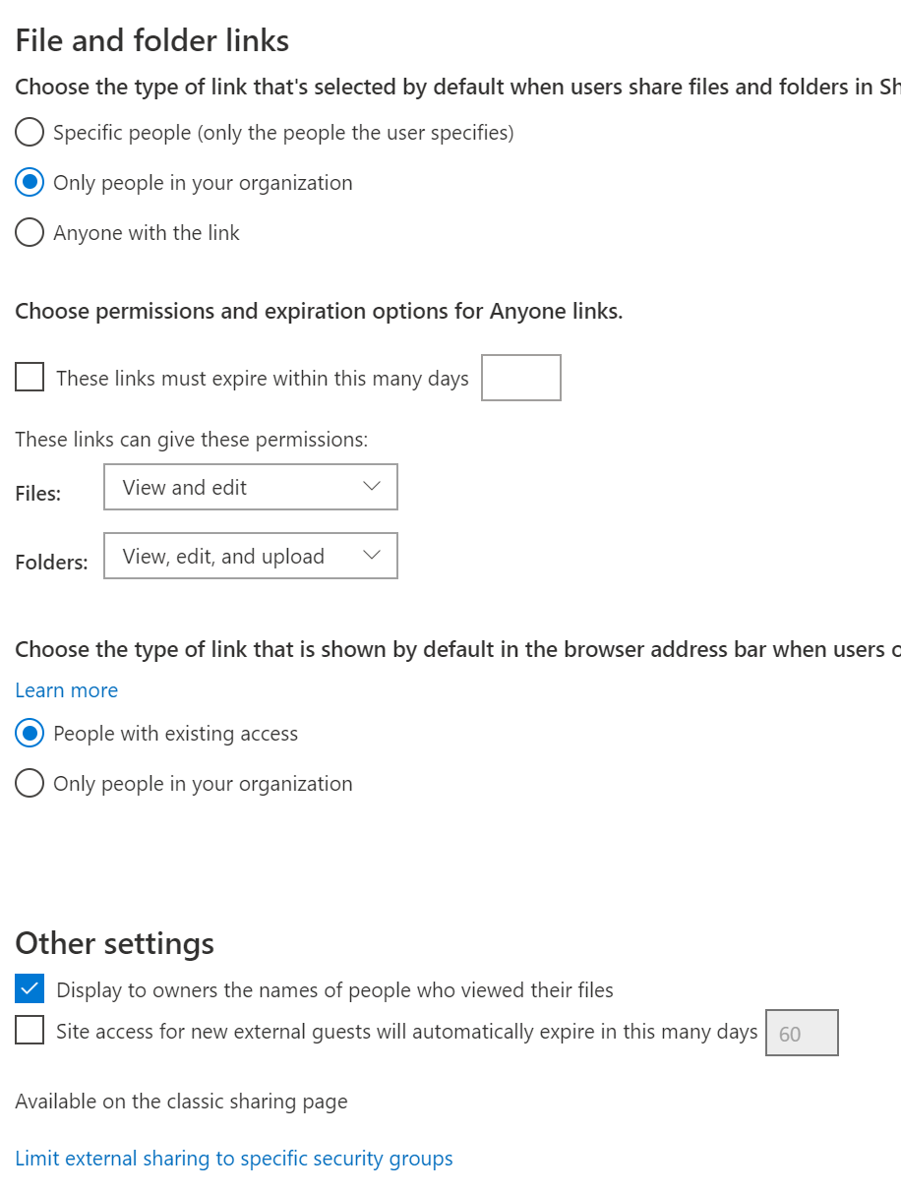
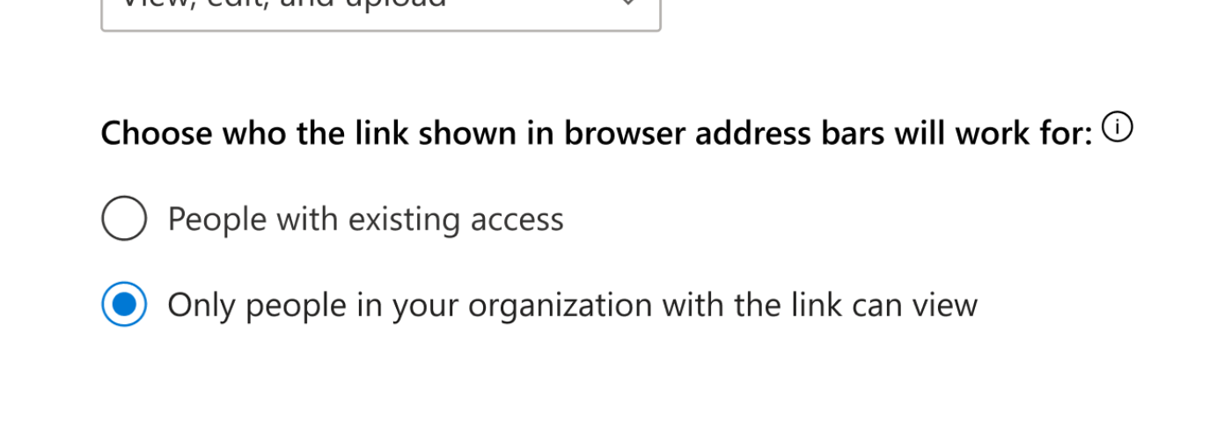
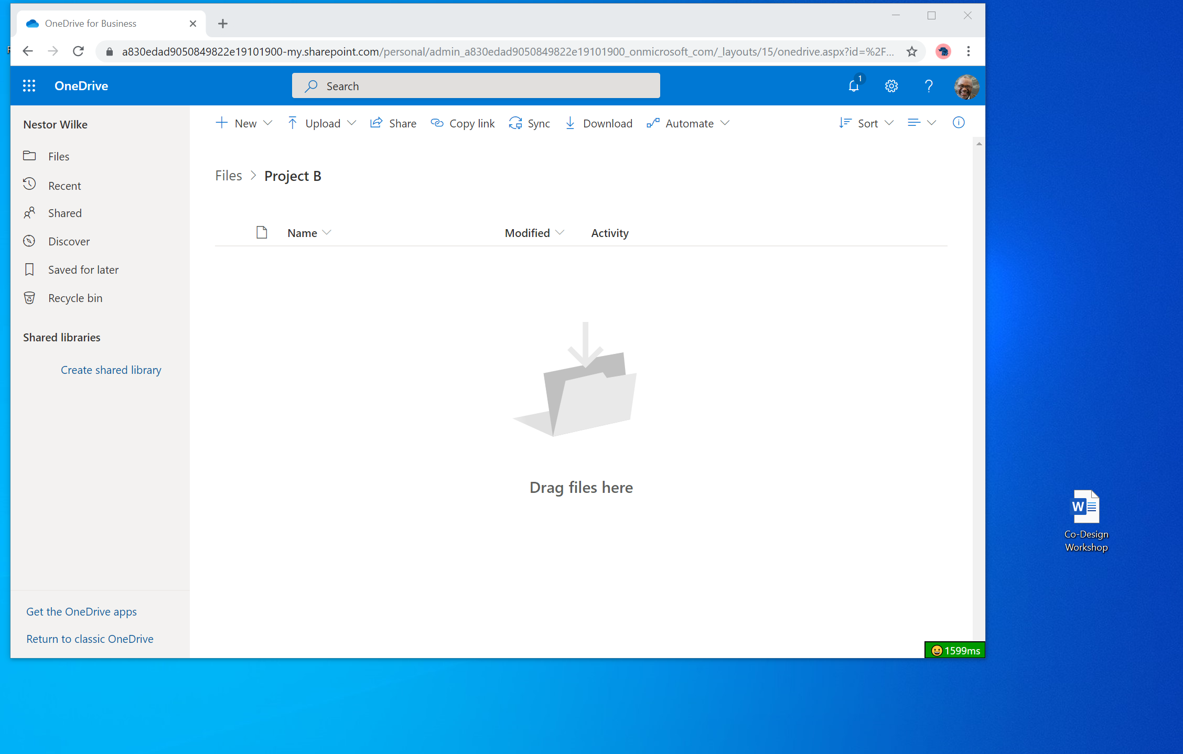

Slide 56
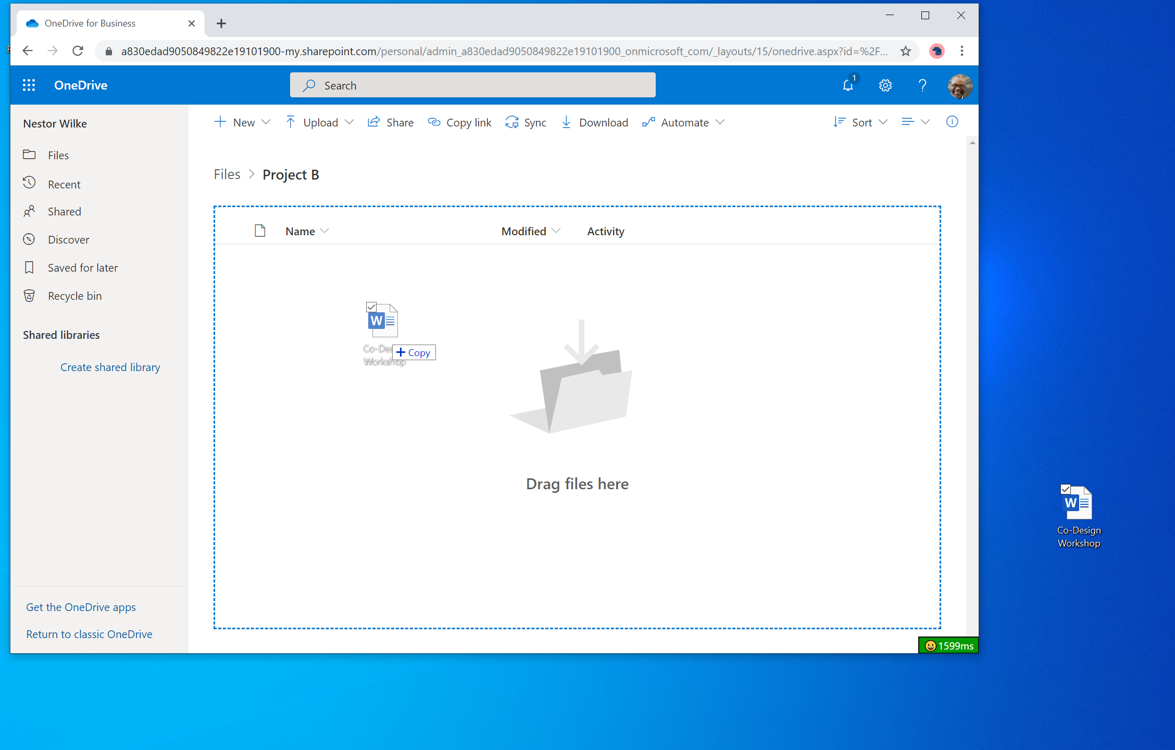

Slide 57
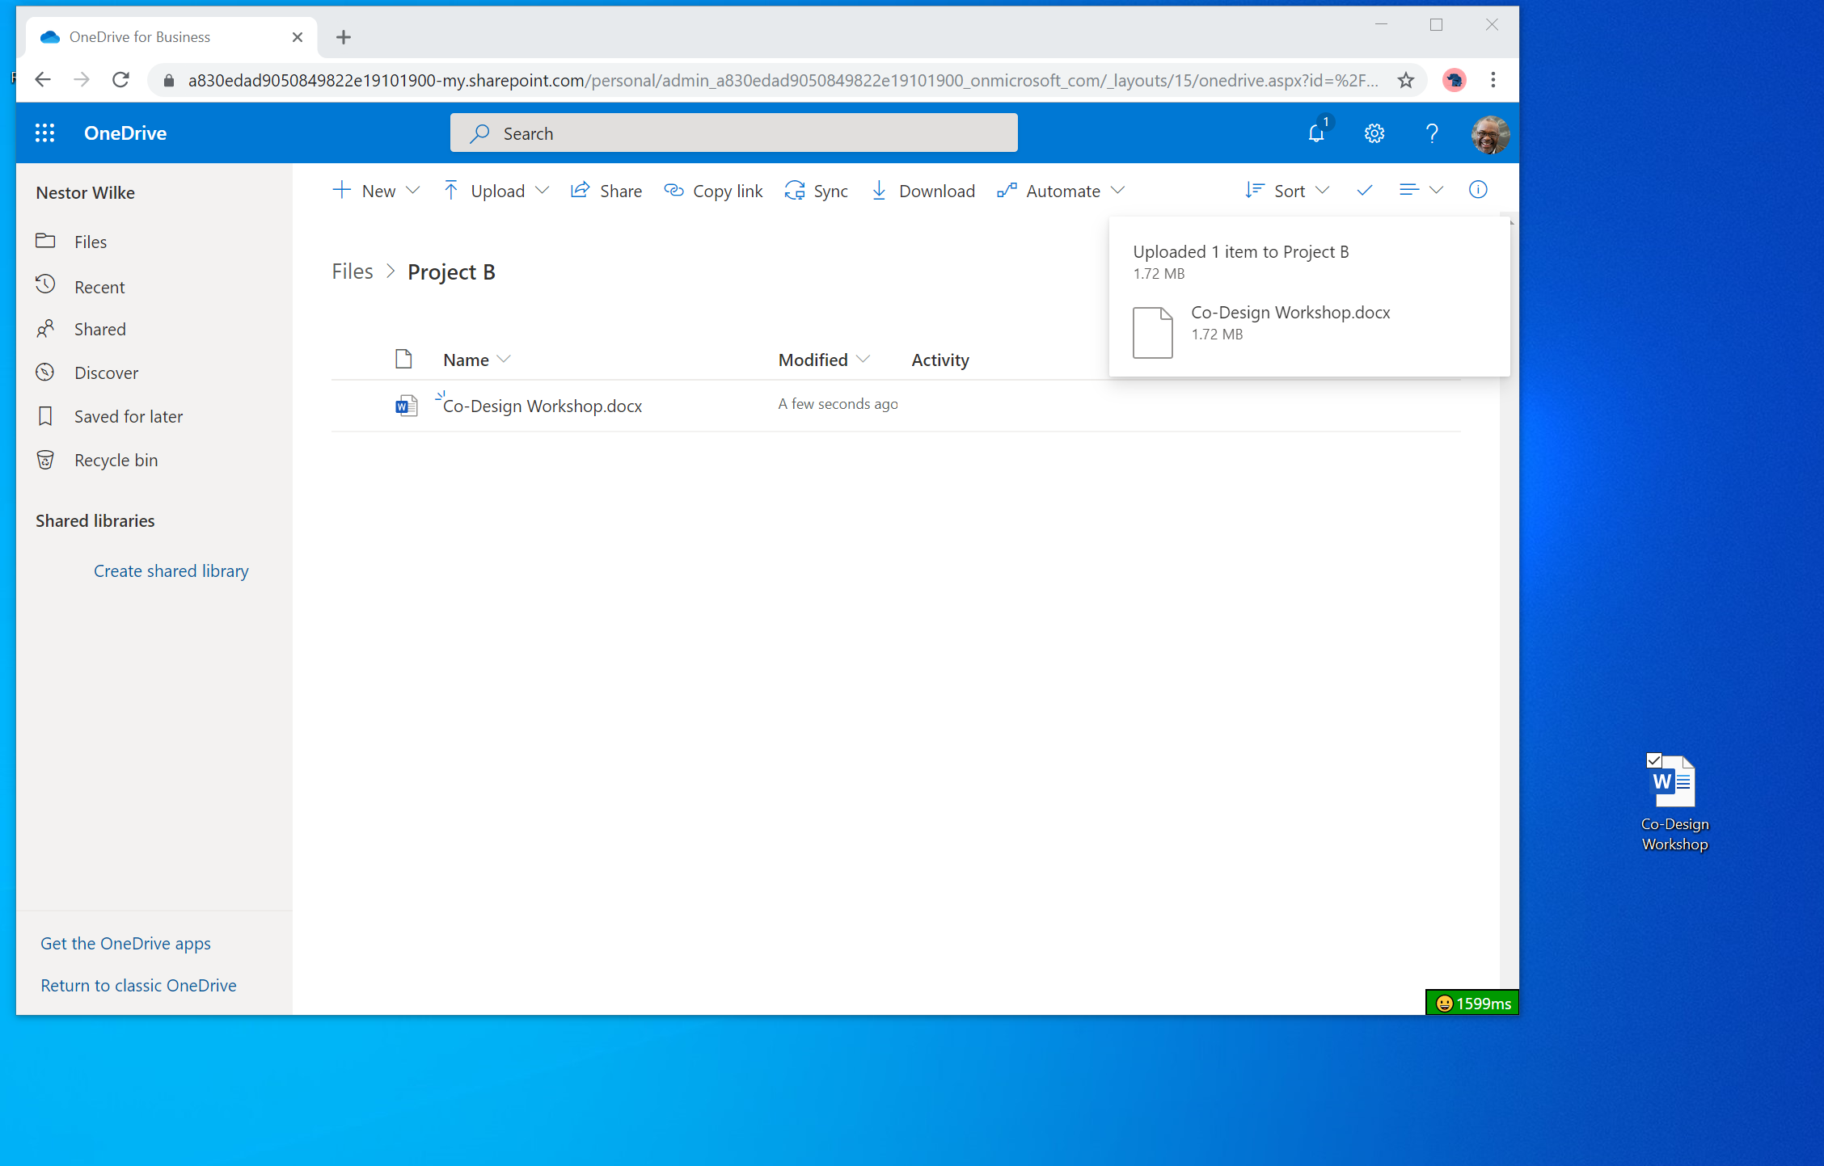


Slide 58
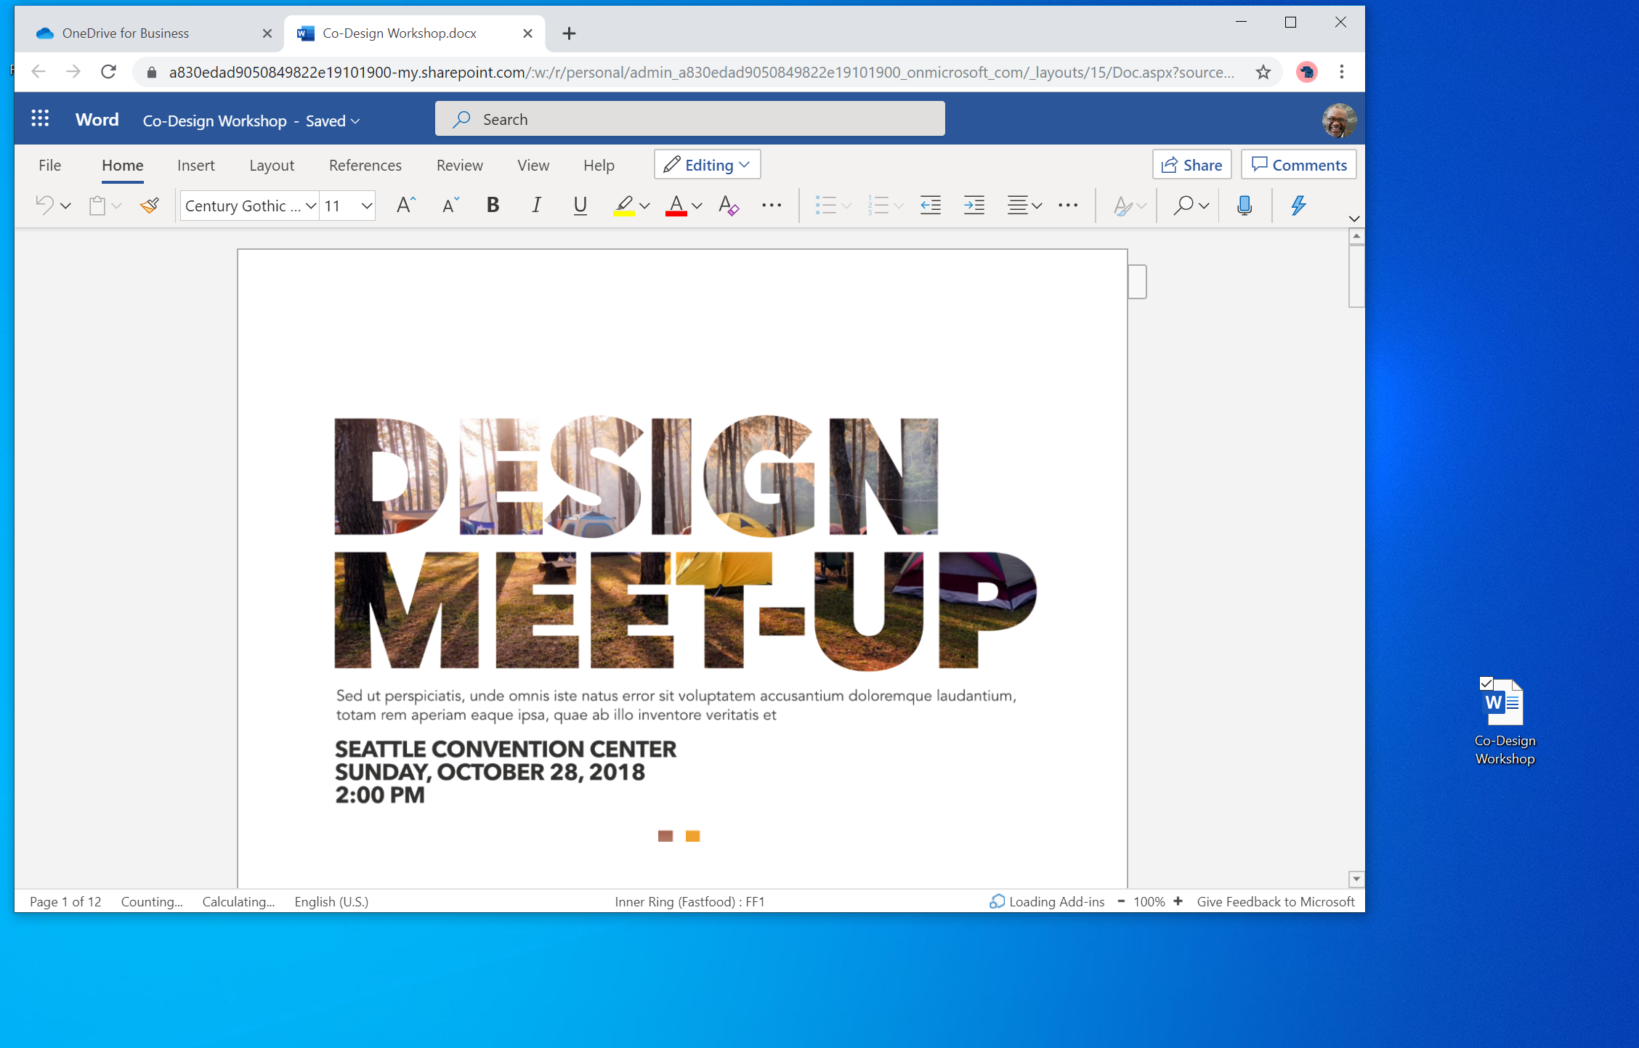

Slide 60
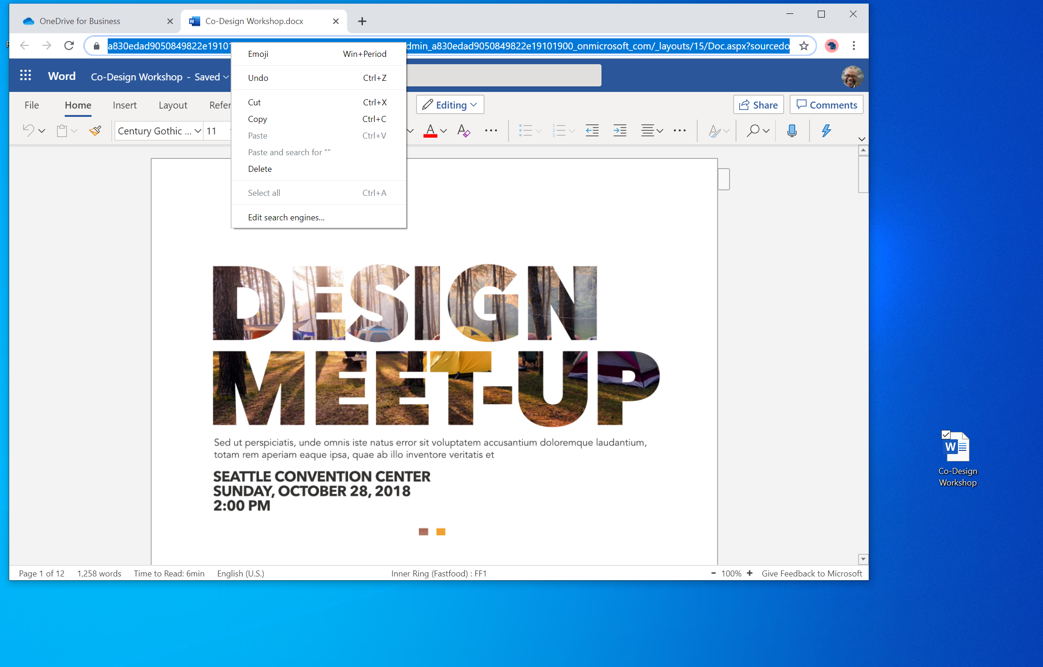

Slide 63
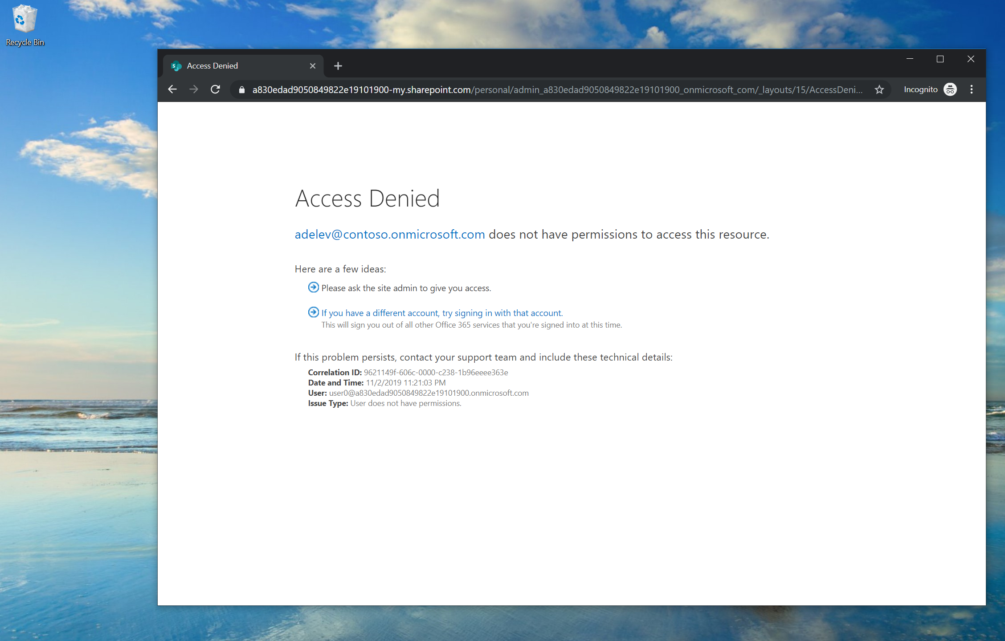

Slide 67
Control who links copied out of the address bar will work for…

Slide 68
…either for people who already have access

Slide 69
…or for anyone in your organization that gets the link

Slide 70
…blocks external users

Slide 71
…requires internal users to have the link

Slide 75
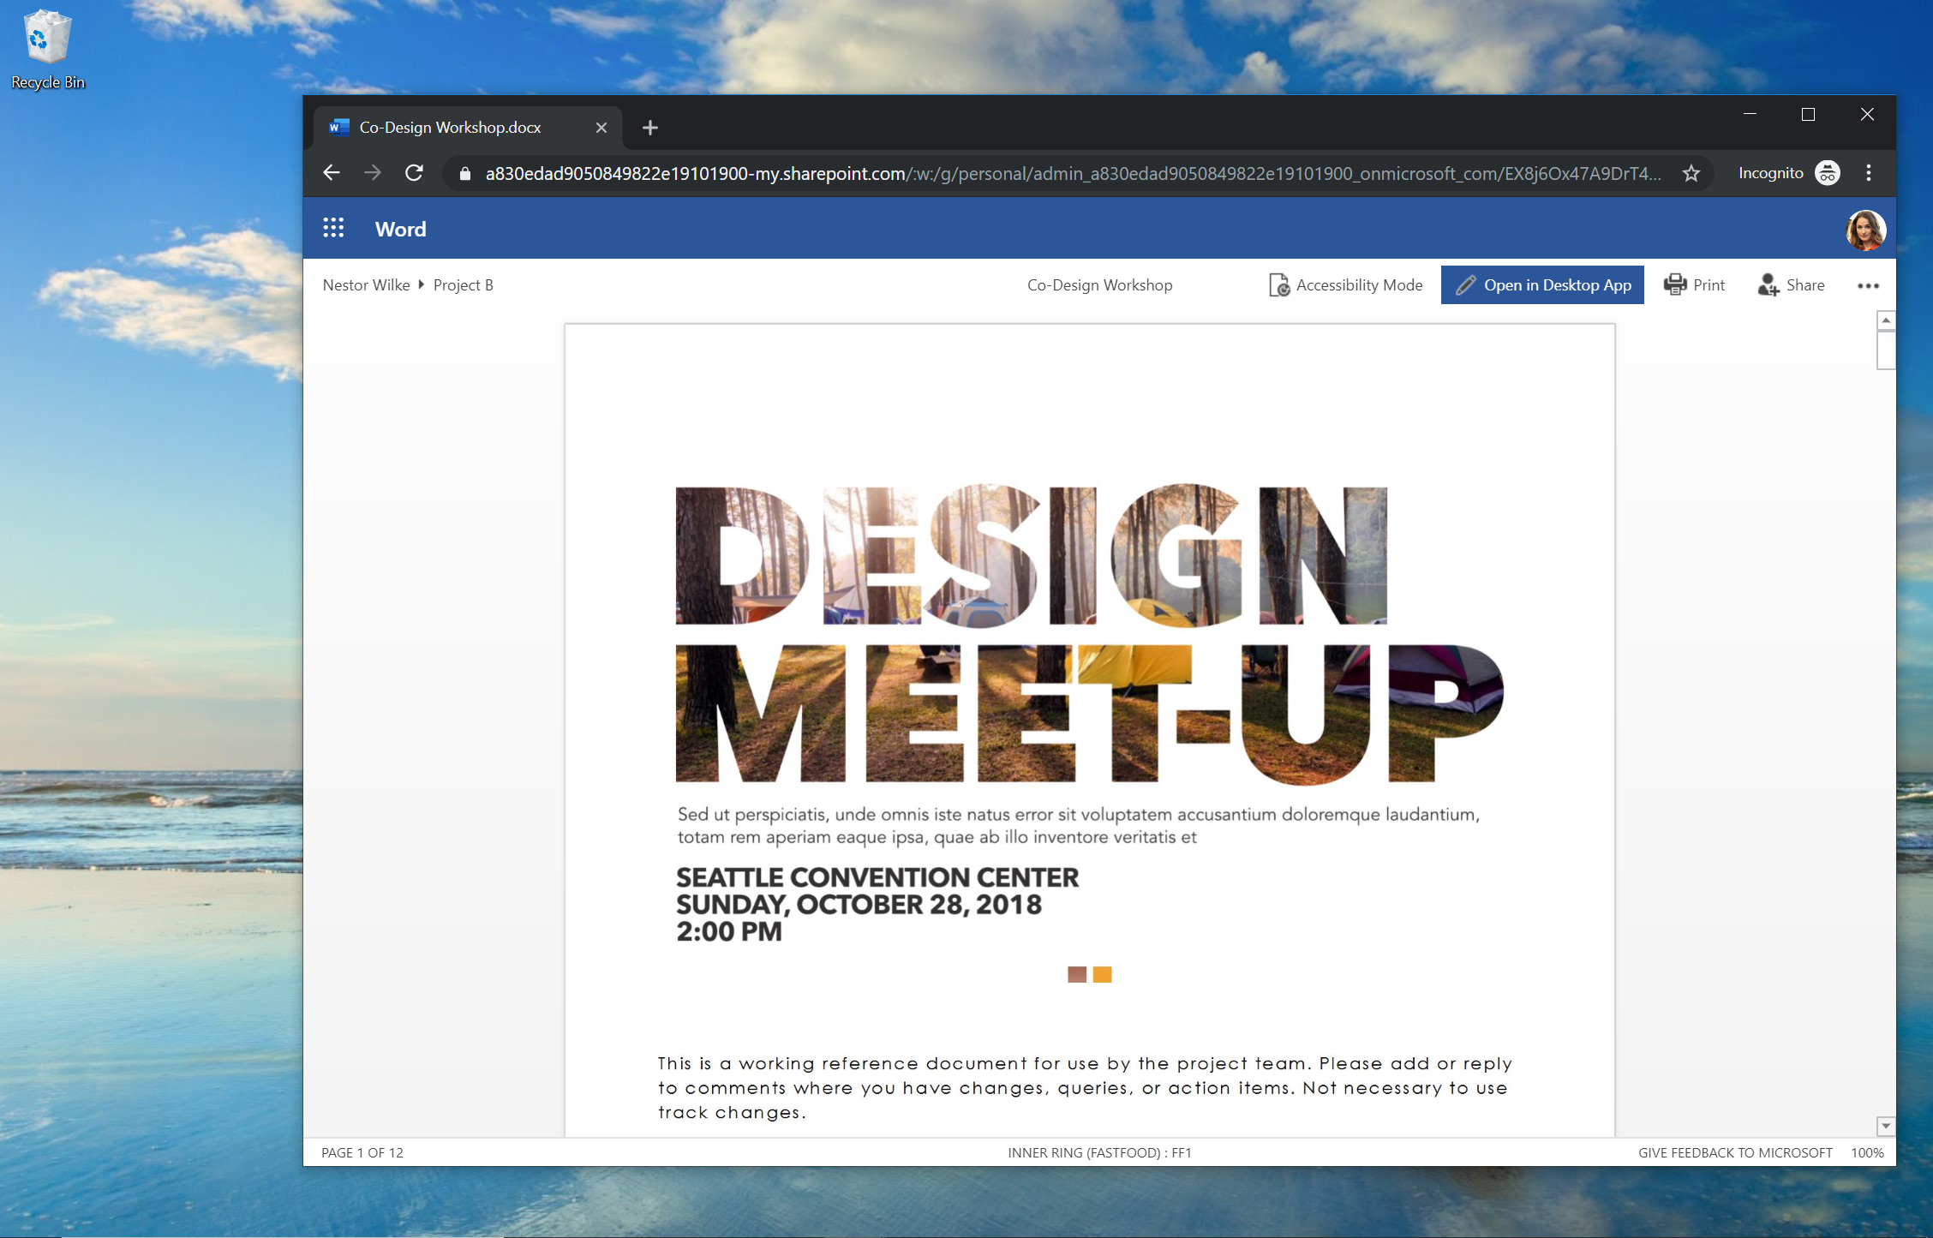

Slide 77
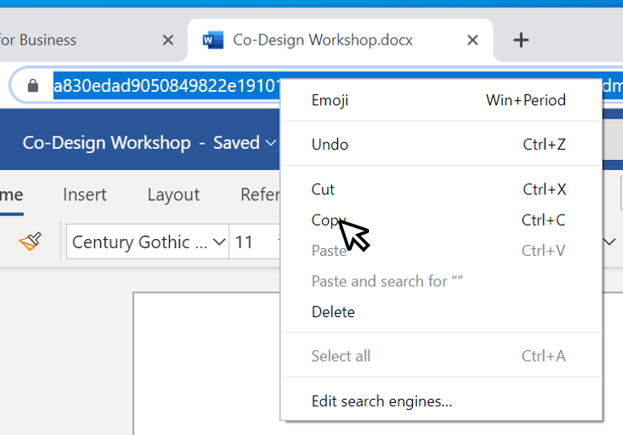
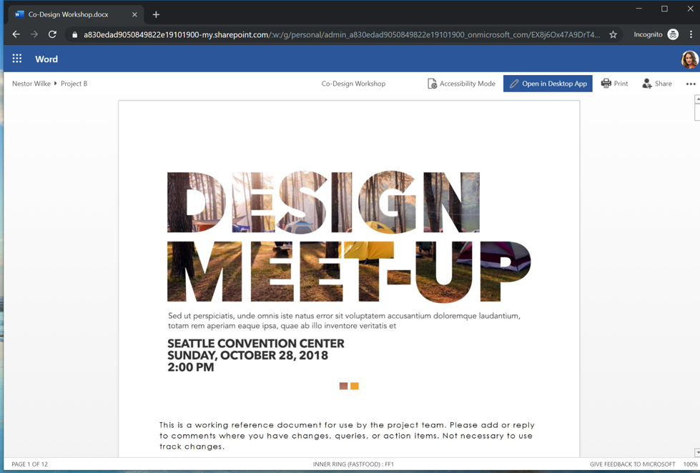
NEW! Address bar sharing
Choose to allow links copied out of address bar to be shareable internally
Enables natural and easy collaboration within your organization
Respects policies
End-users can choose per-file to make the address bar link work only for people with existing access.
Coming early 2020

Slide 78
Agenda
Sharing overview
What’s new for users
Management overview
What’s new for admins

Slide 79

Management Overview

Slide 80
Overview of External Sharing Settings for Admins
Block external sharing for your entire organization
Allow external sharing to only existing guest users
Allow external sharing to authenticated guest users
Allow external sharing to authenticated guest users and via links that work for anyone
Choose the default link type
Choose the default link permission
Require anyone links to expire after some number of days
Prevent users from getting Anyone can edit links to files
Prevent users from getting Anyone can edit links to folders
Let only selected users share externally
Let only selected users share externally and via anyone links
User shorter sharing links for files and folders
Limit external sharing to only allowed domains
Limit external sharing to only denied domains
Prevent external users from sharing items they don’t own
Require external users to prove account ownership
Block external sharing for specific sites
Allow external sharing to only existing guest users for specific sites
Allow external sharing to authenticated guest users for specific sites
Allow external sharing to authenticated guest users and via anyone links for specific sit
Disable people picking experiences for guest users on specific sites

Slide 81

Overview of External Sharing Settings for Admins
Stop working to find Blockers!

Slide 82

Overview of External Sharing Settings for Admins
Keep working to find Green lights!

Slide 83
Overview of External Sharing Settings for Admins
Block
Block external sharing for your entire organization
Allow
Allow external sharing to only existing guest users
Allow
Allow external sharing to authenticated guest users
Allow
Allow external sharing to authenticated guest users and via links that work for anyone
Choose
Choose the default link type
Link Expiration Policy

Slide 84
Overview of External Sharing Settings for Admins
Block external sharing for your entire organization
Allow external sharing to only existing guest users
Allow external sharing to authenticated guest users
Allow external sharing to authenticated guest users and via links that work for anyone
Choose the default link type
Choose the default link permission
Require anyone links to expire after some number of days
Prevent users from getting Anyone can edit links to files
Prevent users from getting Anyone can edit links to folders
Let only selected users share externally
Let only selected users share externally and via anyone links

Slide 85
Make it simple…
Use only 4 words to decide about external sharing settings:
Who
Which
How
What

Slide 86
Managing external sharing
Control WHO can share to external users
Everyone
Only specific people
No one
Control WHICH external users can be shared with
Anyone
Only authenticated users
Only authenticated users except specific domains
Only authenticated users in specific domains
No one
Control WHAT can be shared externally
Anything
Only specific libraries
Only files without sensitive content
Control HOW externally shareable links can be used
Default
Enabled, but not default
Mandatory expiration date
Block externally-shareable edit links
Disabled

Slide 87
DEMO​ External Sharing Report​ Tenant Settings: External Sharing by site collection Expiration Policy – Tenant or Site level Extra tips: Monitoring anonymous links generated Audit logs | Power Automate to retain logs and notify users

Slide 88
Managing external sharing
Control WHO can share to external users
Everyone
Only specific people
No one

Slide 89
Contoso
Everyone can share externally

Slide 90
Contoso
Only specific people can share externally

Slide 91
Contoso
No one can share externally

Slide 92
Managing external sharing
Control WHO can share to external users
Everyone
Only specific people
No one
Control WHICH external users can be shared with
Anyone
Only authenticated users
Only authenticated users except specific domains
Only authenticated users in specific domains
No one

Slide 93
Contoso
Share with anyone

Slide 94
Contoso
Share with only authenticated users

Slide 95
Contoso
Fabrikam.com
Block sharing with specific domains

Slide 96
Contoso
Microsoft.com
Allow sharing with only specific domains

Slide 97
Contoso
Allow sharing with only specific Guests

Slide 98
Managing external sharing
Control WHAT can be shared externally
Anything
Only specific libraries
Only files without sensitive content

Slide 99

Contoso
Eugene’s OneDrive
Michael’s OneDrive
Rafael’s OneDrive
Finance team library
Sales team library
Enable external sharing without restrictions

Slide 100
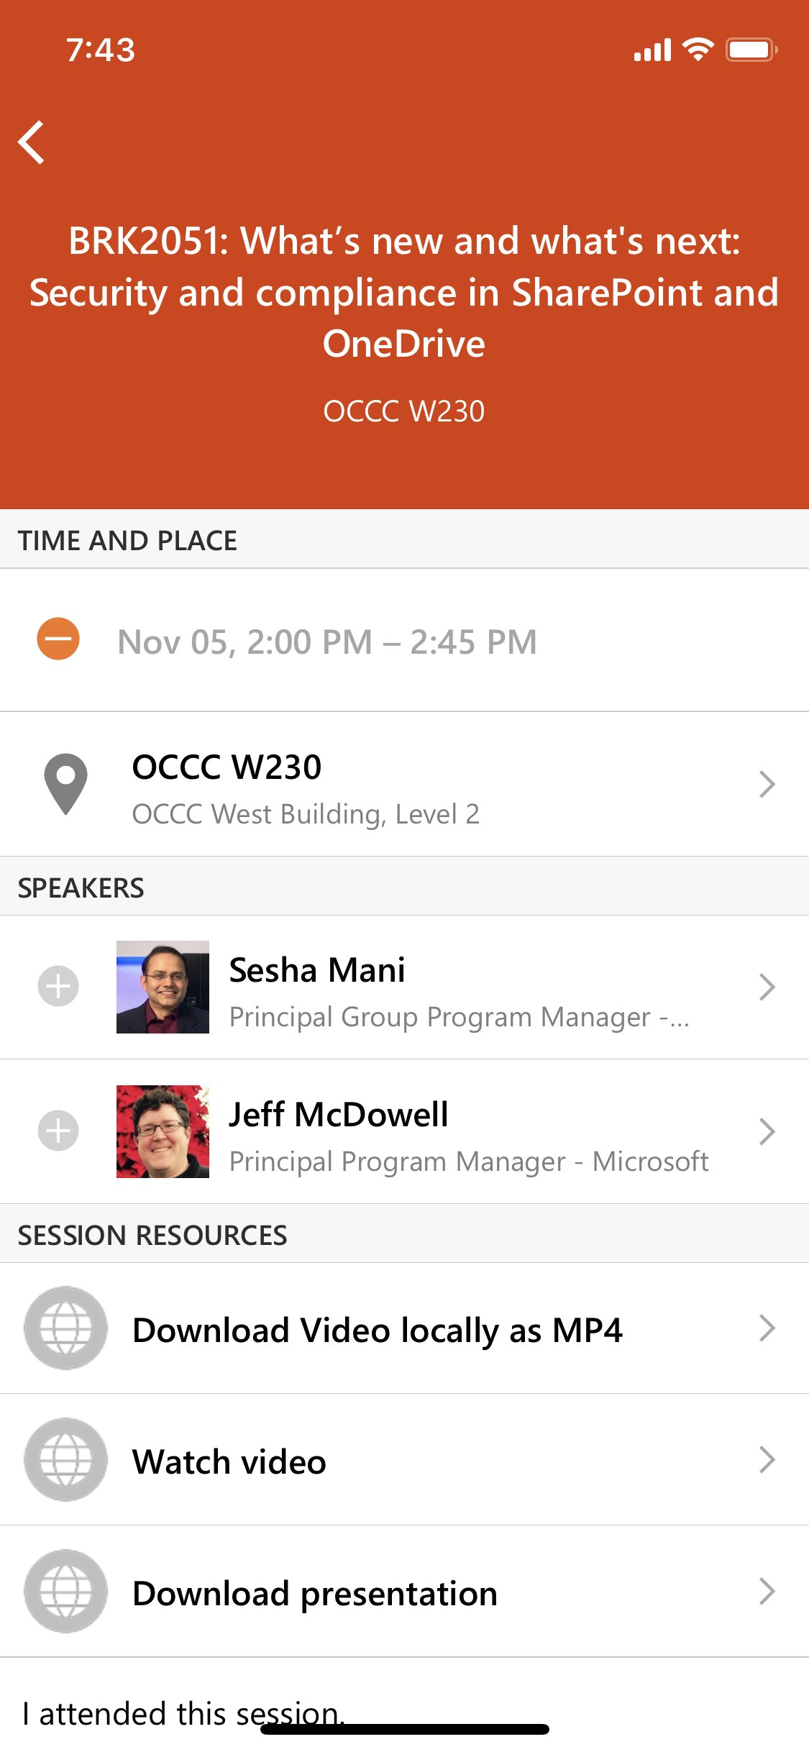


Contoso
Eugene’s OneDrive
Michael’s OneDrive
Rafael’s OneDrive
Morale event photos
Project Raven strategy doc
Spec proposal for review
Finance team library
Secret Santa list
Pre-earnings numbers
Sales team library
Block external sharing of sensitive files

Slide 101
Contoso
Eugene’s OneDrive
Michael’s OneDrive
Rafael’s OneDrive
Morale event photos
Project Raven strategy doc
Spec proposal for review
Finance team library
Secret Santa list
Pre-earnings numbers
Sales team library
Block external sharing of sensitive files

Slide 102
Contoso
Eugene’s OneDrive
Michael’s OneDrive
Rafael’s OneDrive
Finance team library
Sales team library
Block external sharing from users’ OneDrives

Slide 103
Contoso
Eugene’s OneDrive
Michael’s OneDrive
Rafael’s OneDrive
Finance team library
Sales team library
Enable external sharing in only specific libraries

Slide 104
Managing external sharing
Control WHAT can be shared externally
Anything
Only specific libraries
Only files without sensitive content
Control HOW externally shareable links can be used
Default
Enabled, but not default
Mandatory expiration date
Block externally-shareable edit links
Disabled

Slide 105
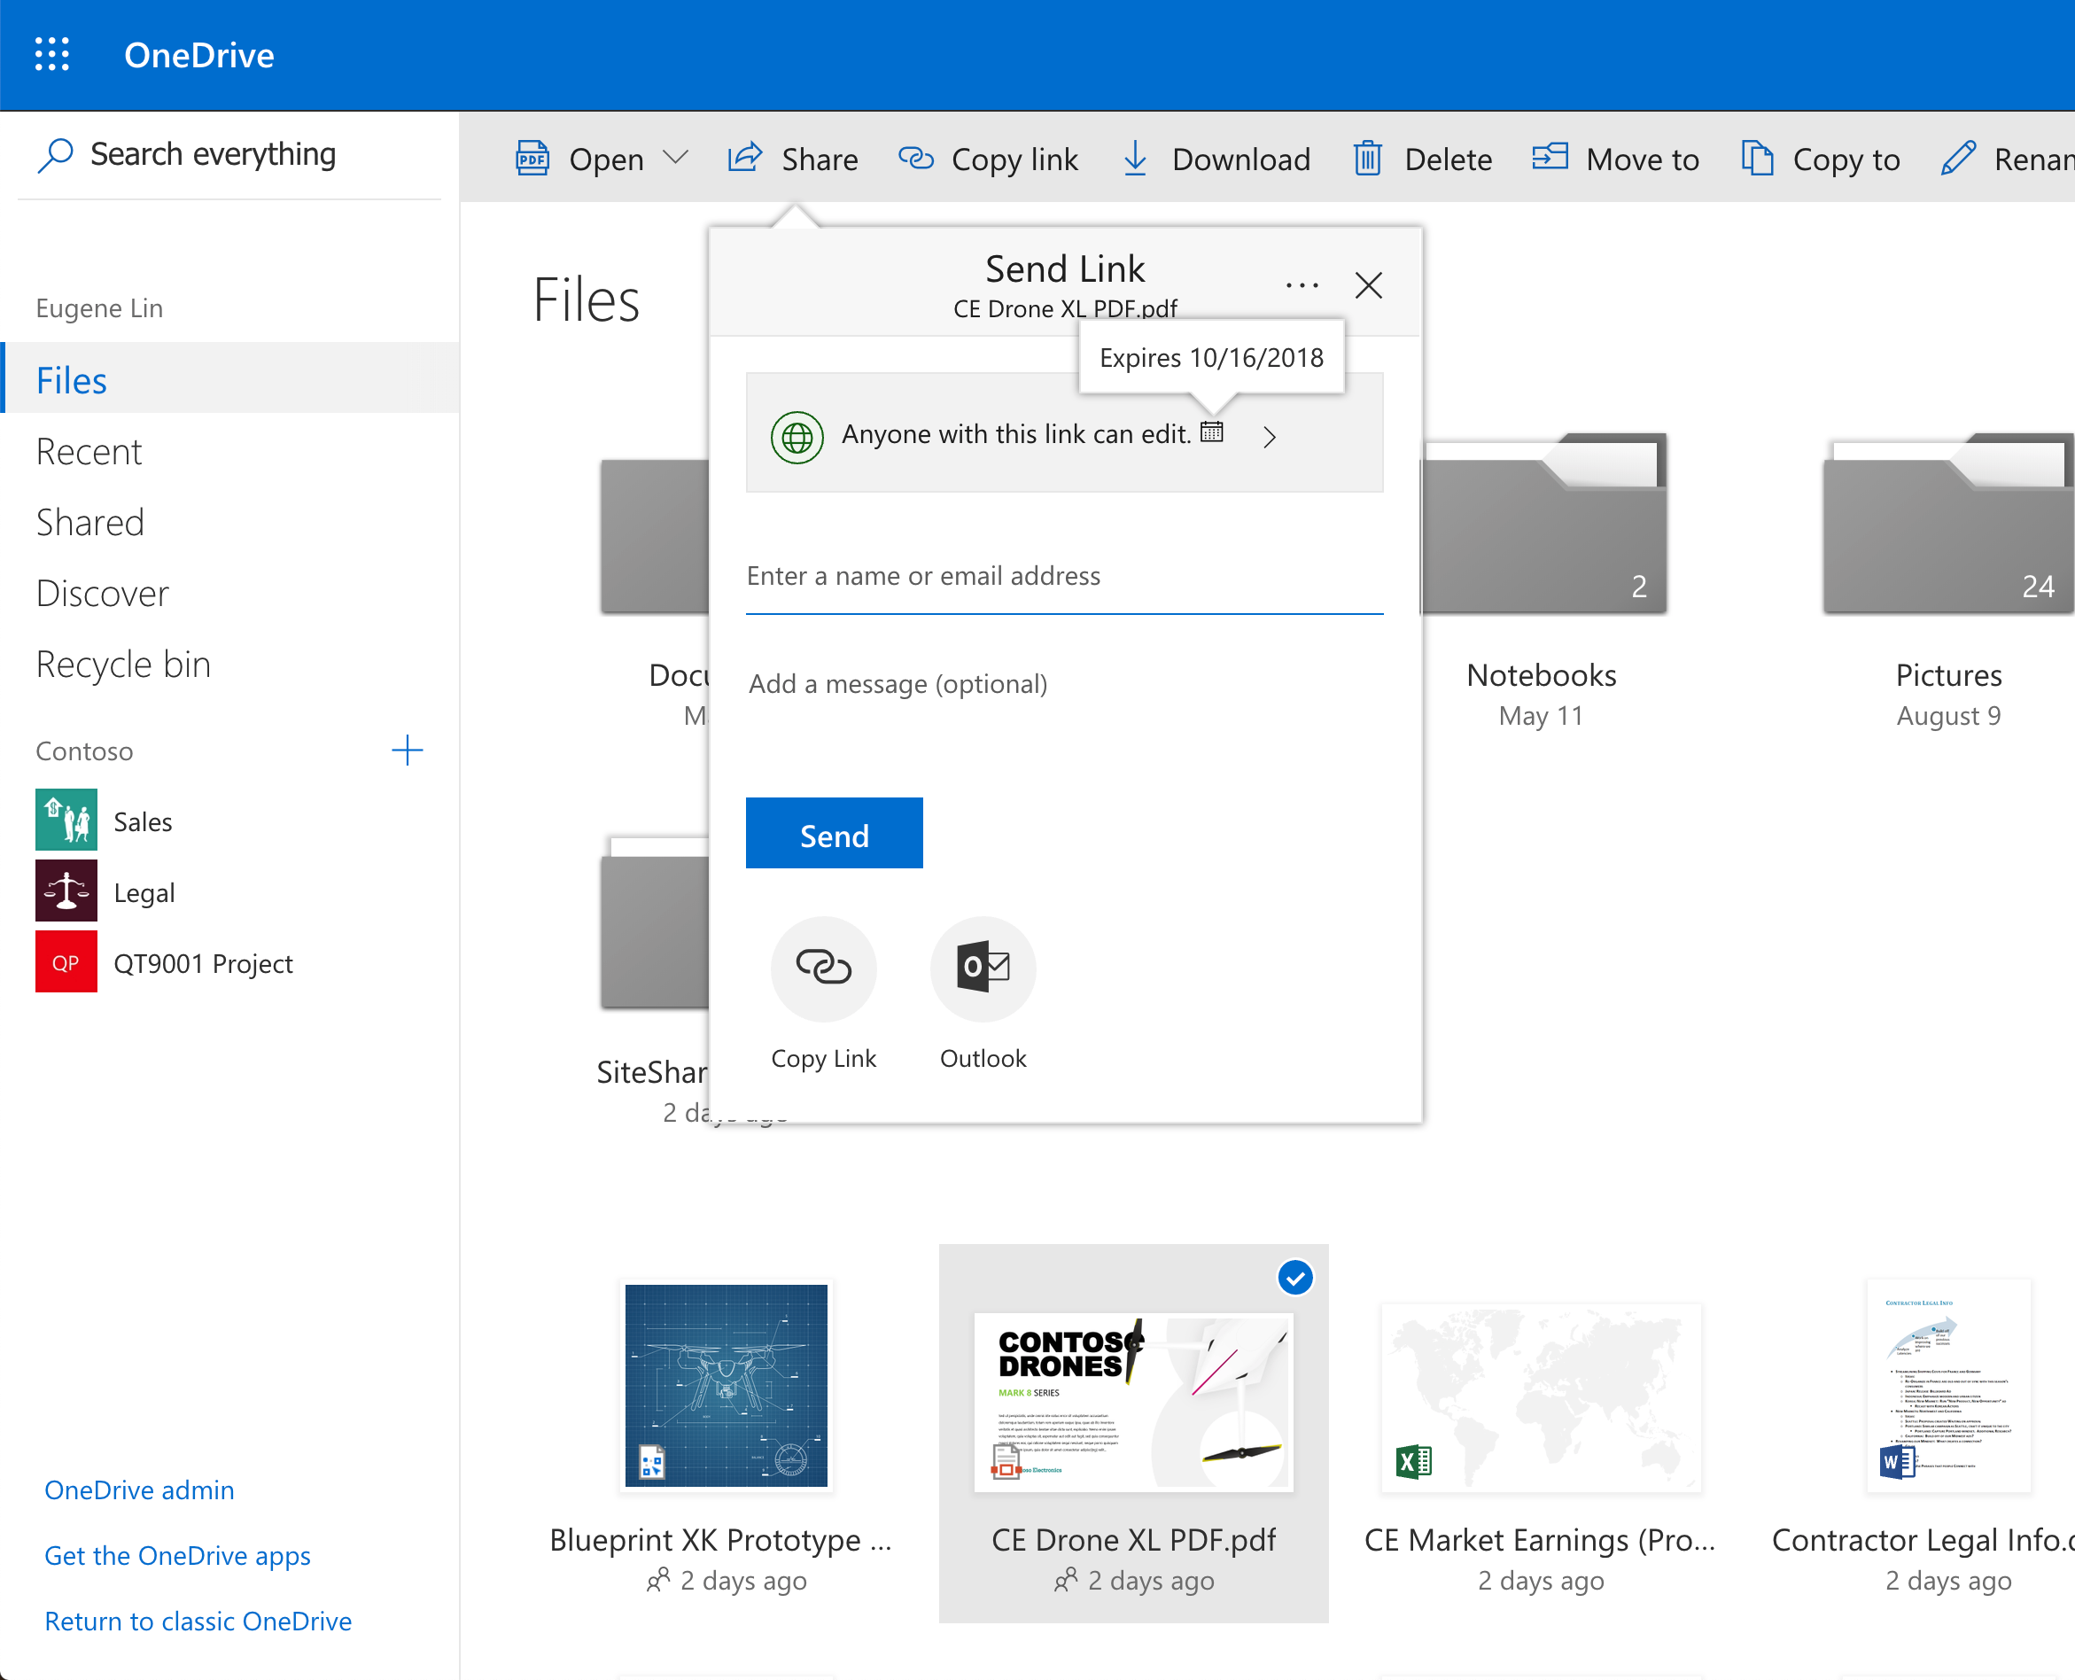
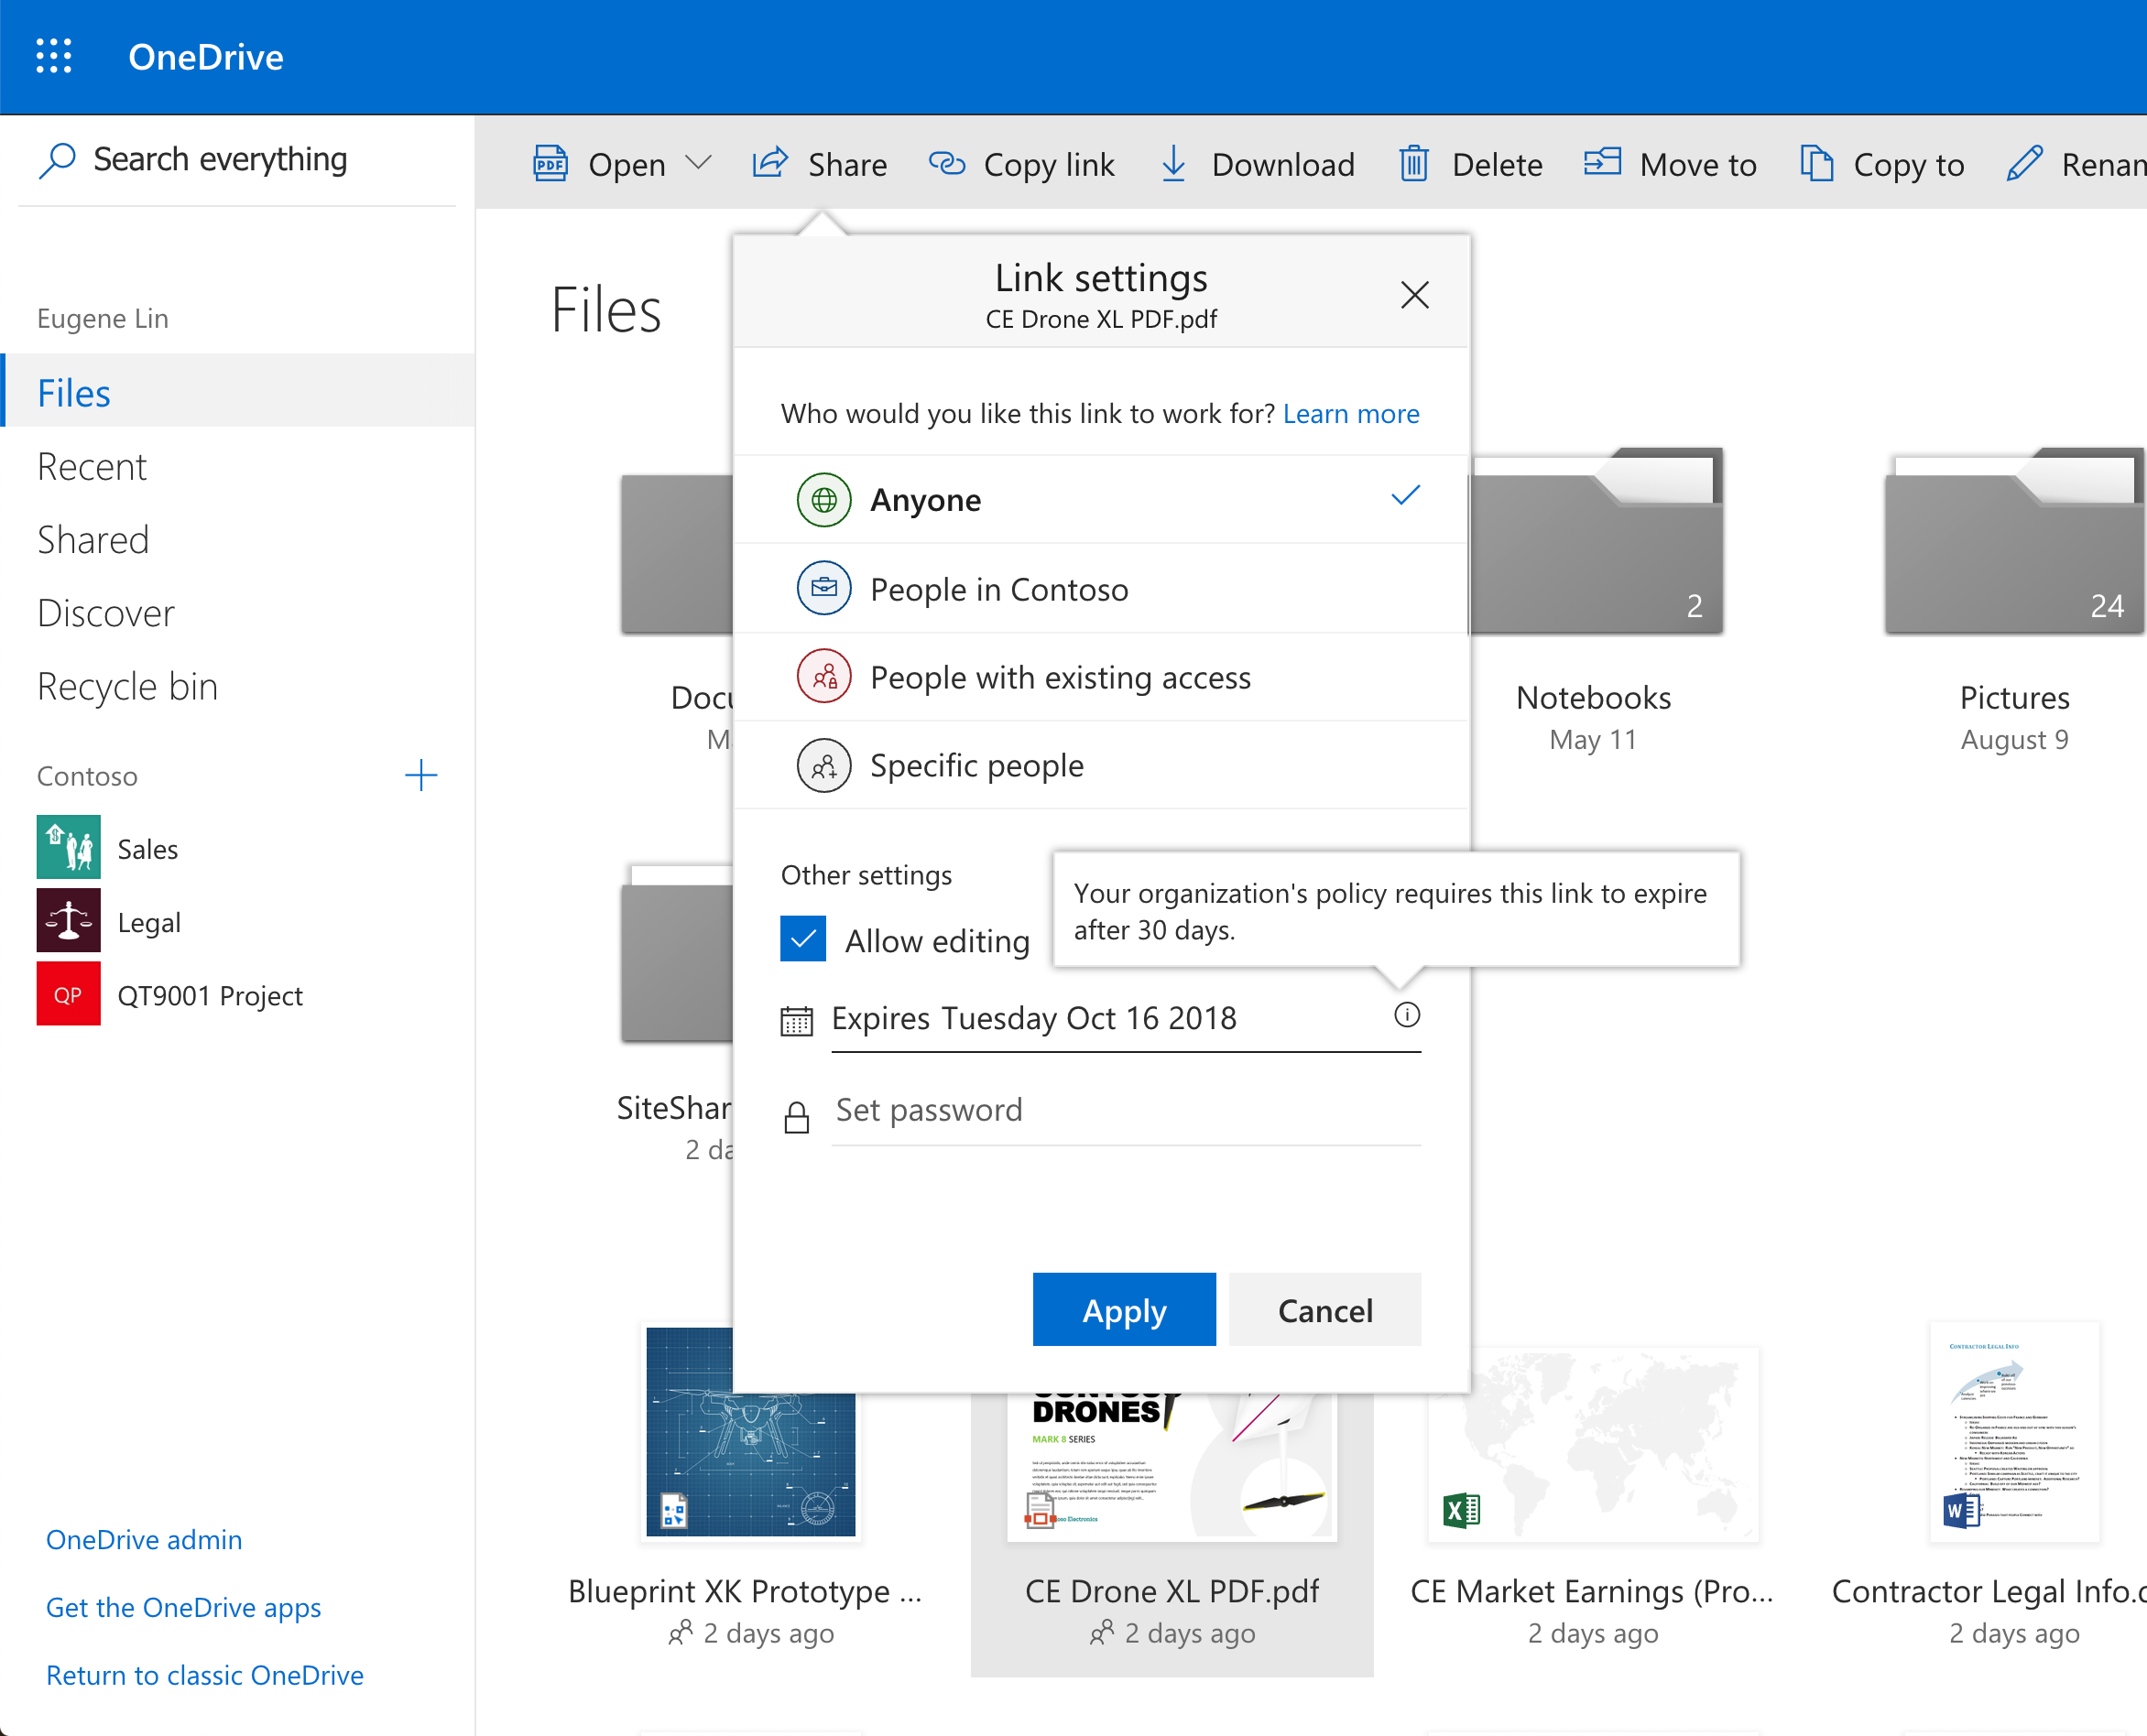
Mandatory link expiration
Require expiration on links that work for anyone

Slide 106
Mandatory link expiration
... within the timeframes you specify

Slide 107
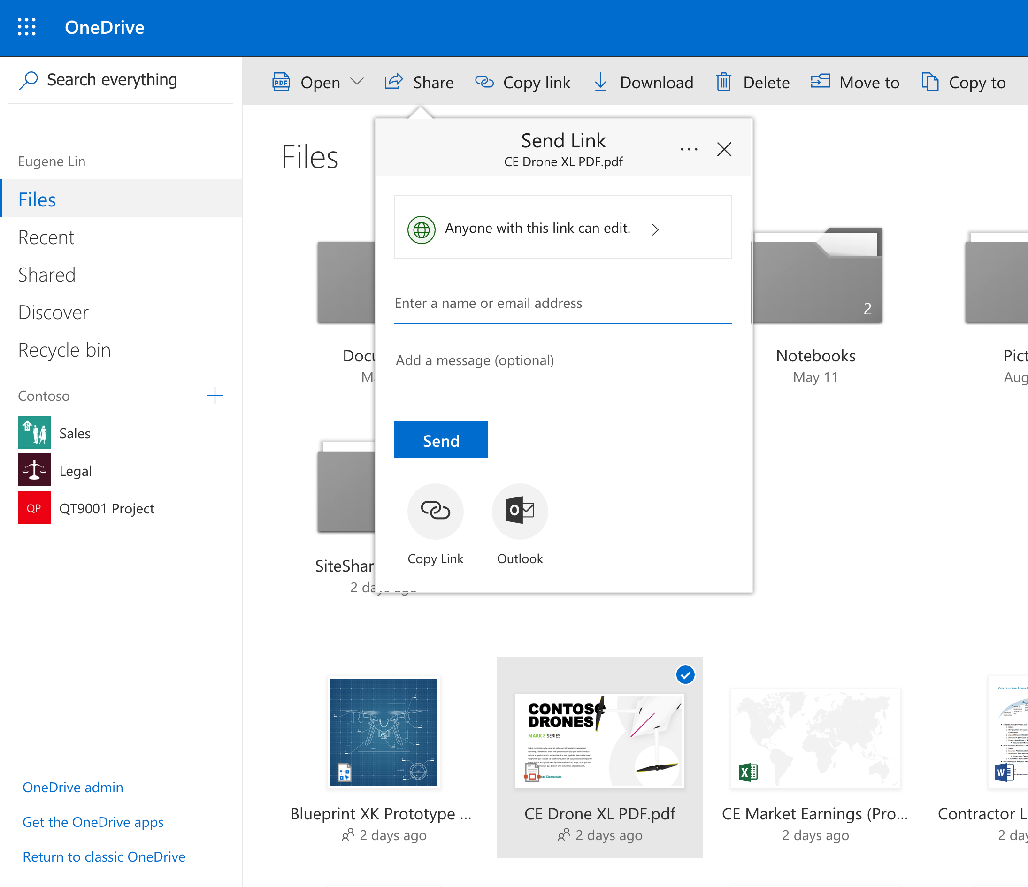
Default link types
Default to links that work for anyone

Slide 108
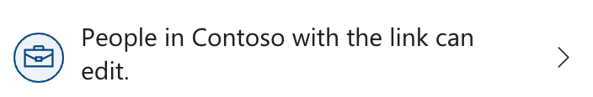
Default link types
Default to internally shareable links

Slide 109
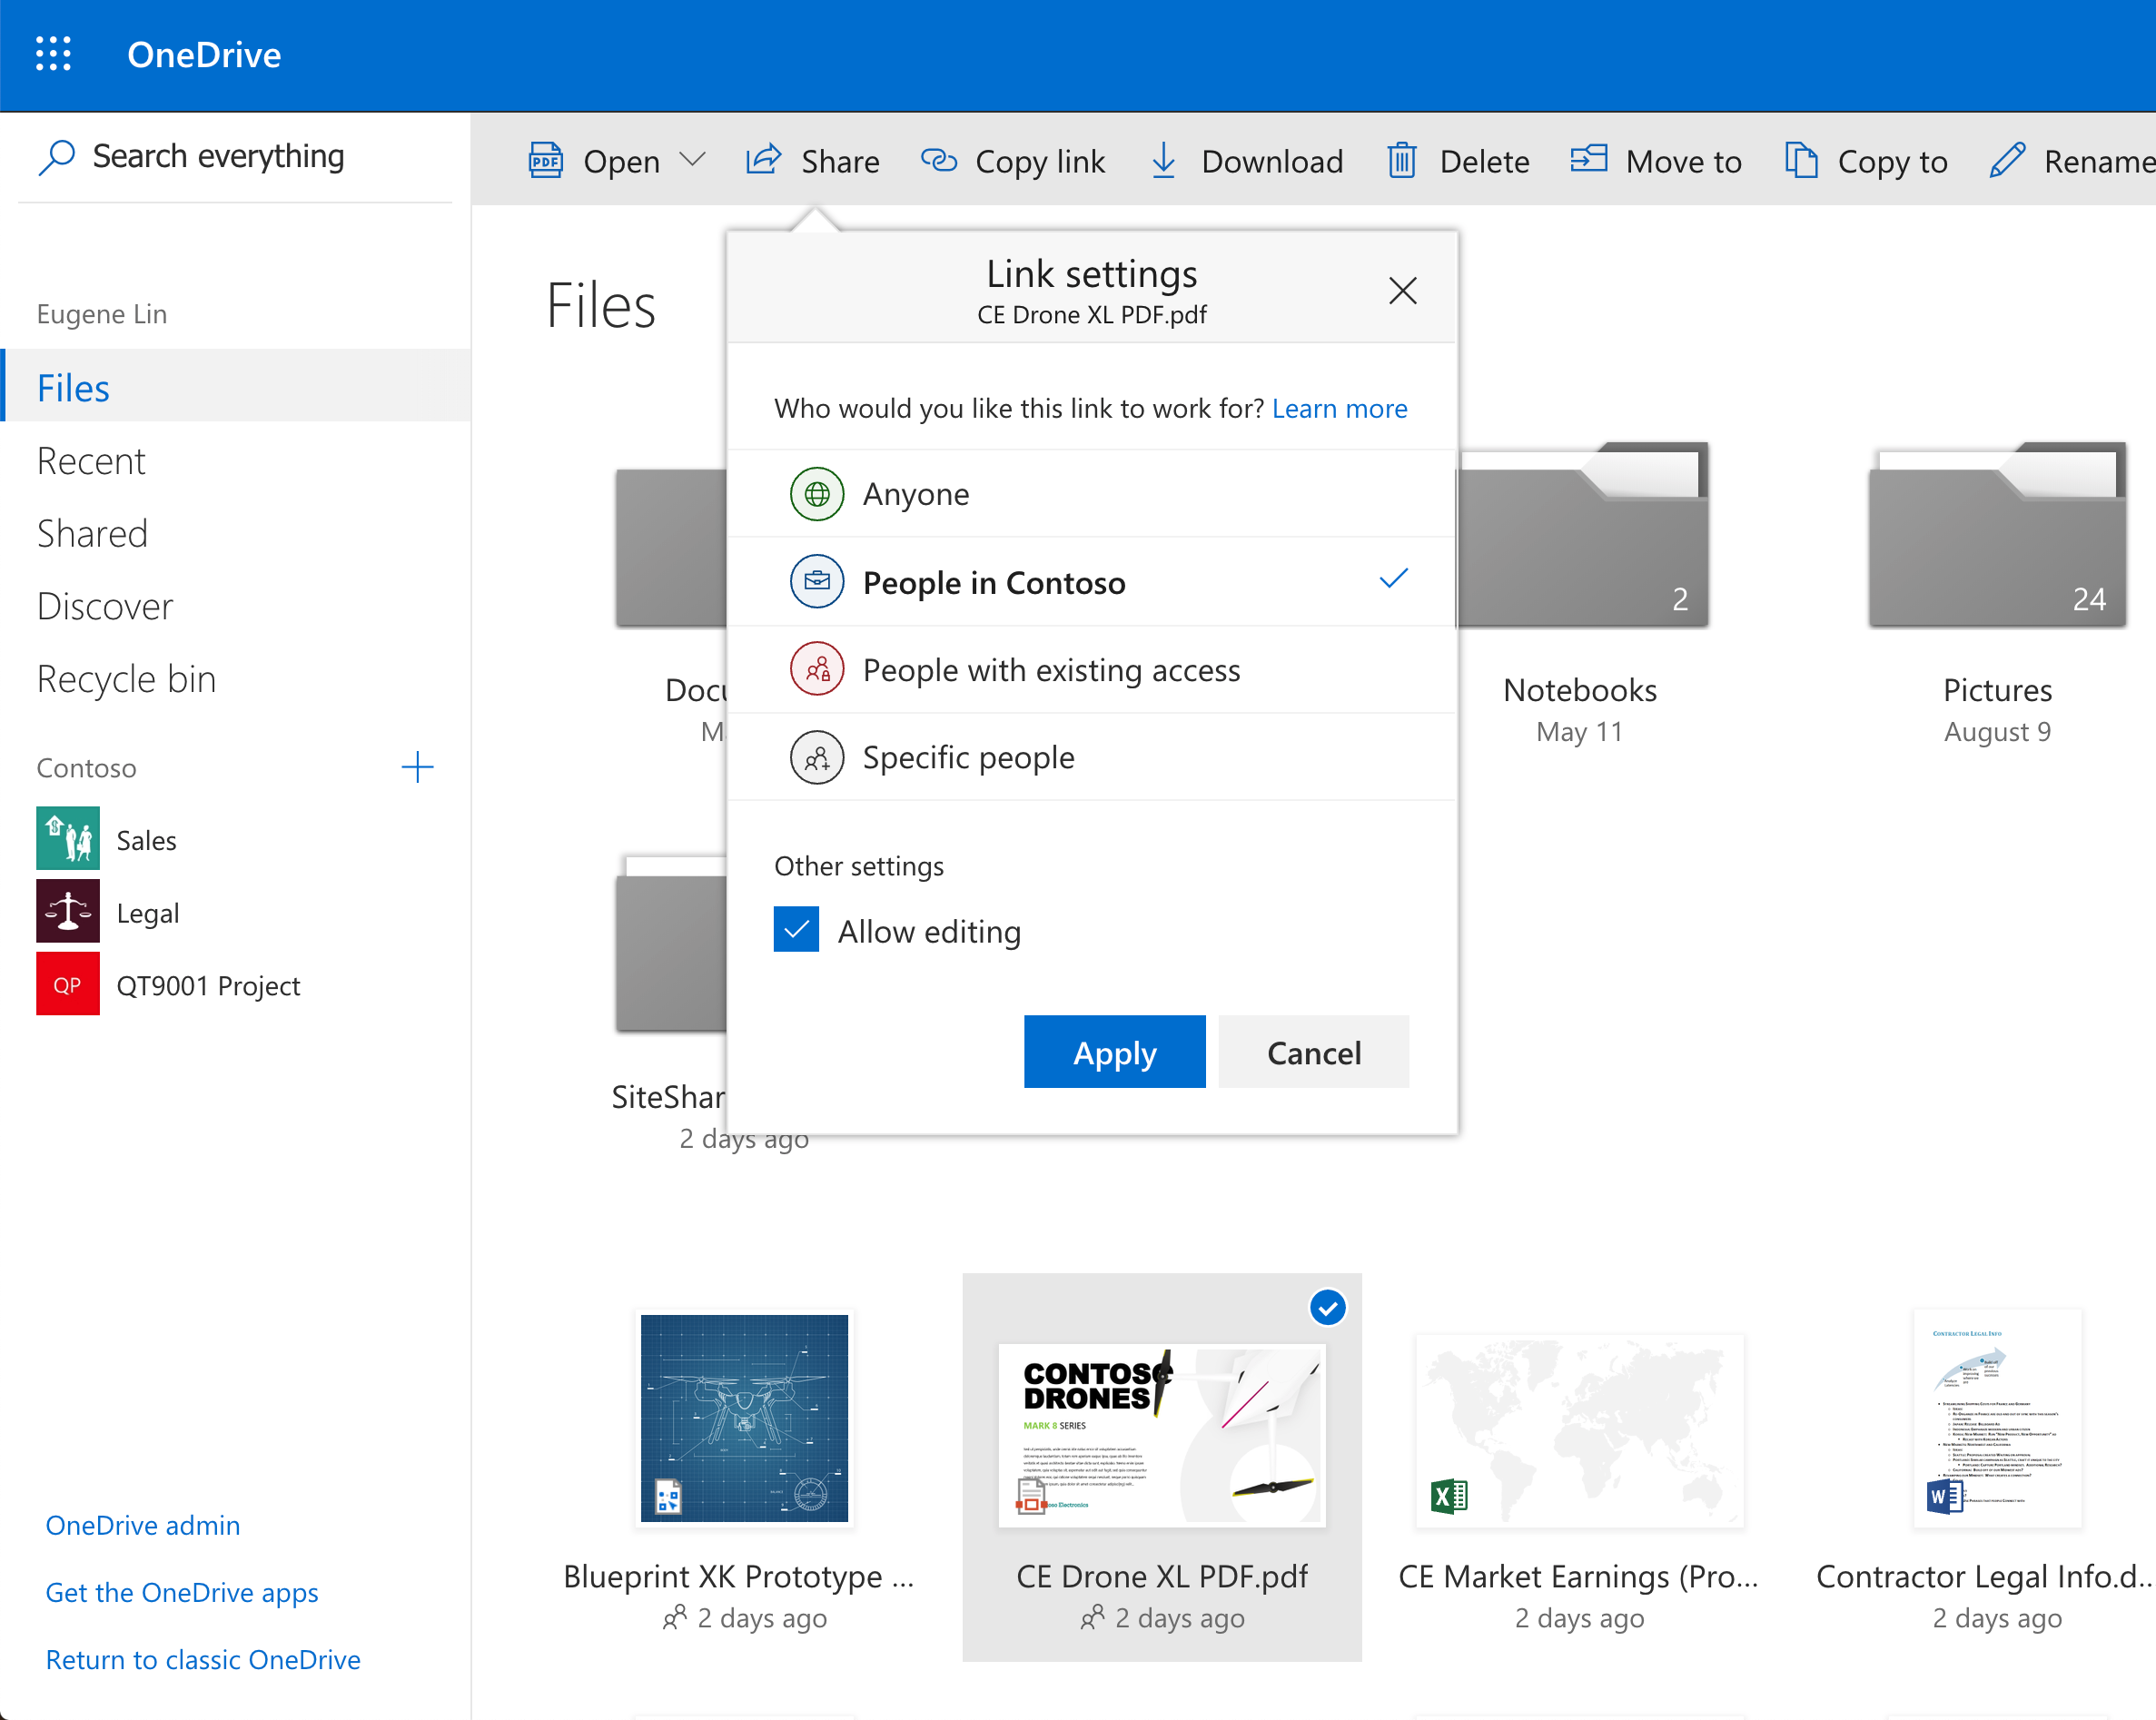
Default link types
… while enabling users to switch if needed

Slide 110
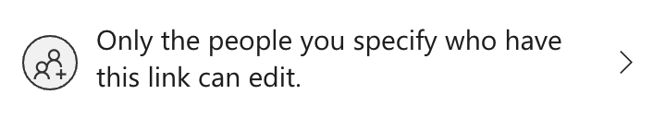
Default link types
Default to links that only work for specified people

Slide 111

Default link permission
Default to edit

Slide 112
Default link permission
Default to view

Slide 113
Managing external sharing
Control WHO can share to external users
Everyone
Only specific people
No one
Control WHICH external users can be shared with
Anyone
Only authenticated users
Only authenticated users except specific domains
Only authenticated users in specific domains
No one
Control WHAT can be shared externally
Anything
Only specific libraries
Only files without sensitive content
Control HOW externally shareable links can be used
Default
Enabled, but not default
Mandatory expiration date
Block externally-shareable edit links
Disabled

Slide 114
Agenda
Sharing overview
What’s new for users
Management overview
What’s new for admins

Slide 115

What’s new for admins

Slide 116
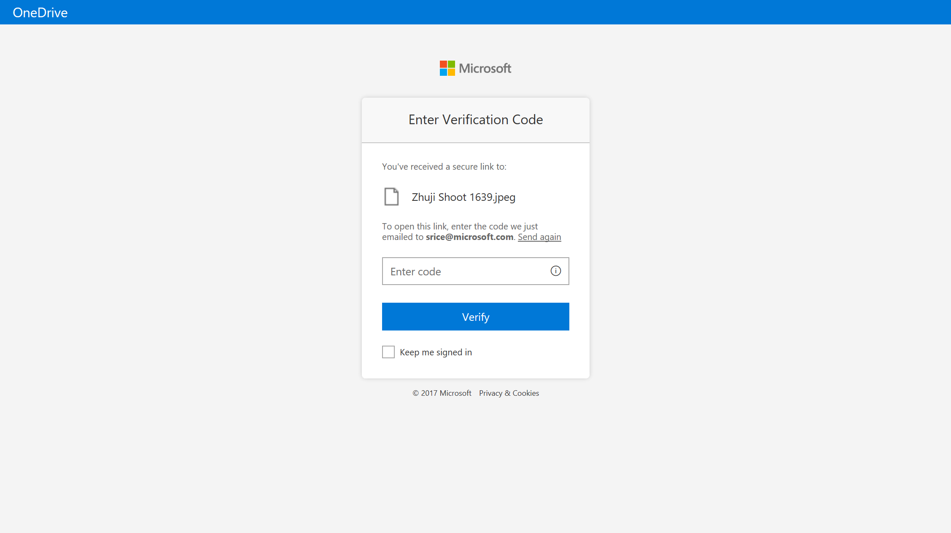
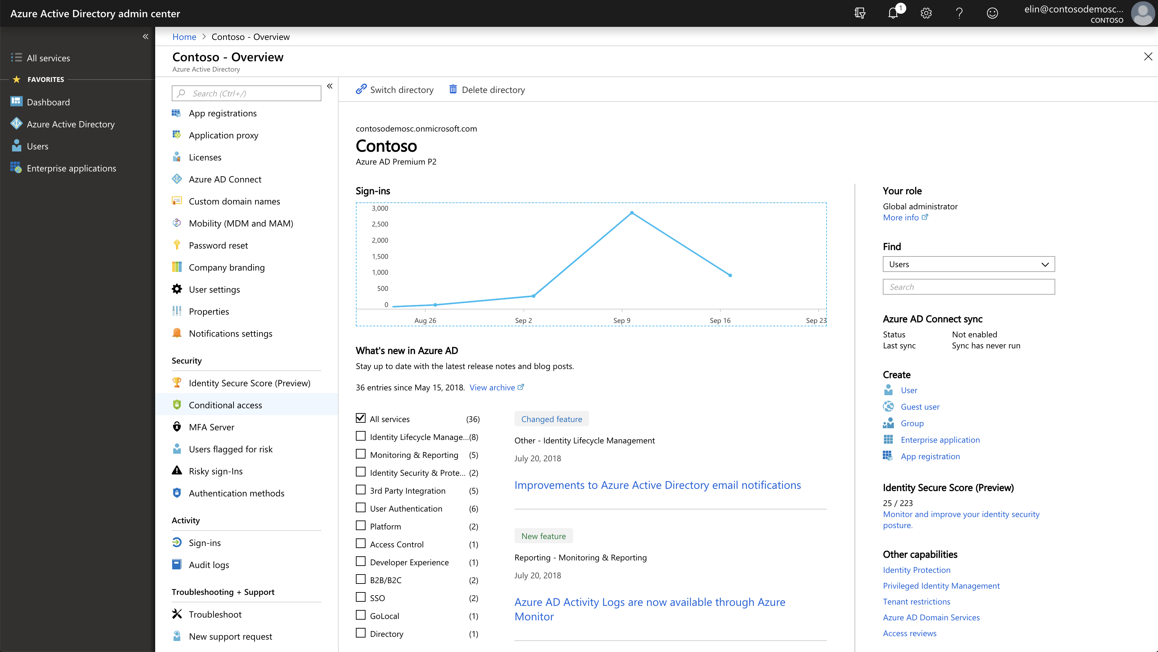
NEW! Azure AD B2B for one-time passcode users
Share securely with anyone in the world
Simple verification with one-time passcode
AAD B2B guest management
Conditional access
Google auth federation
Guest do not require O365 licenses

Slide 117
NEW! Azure AD B2B for one-time passcode users
Share securely with anyone in the world
Simple verification with one-time passcode
AAD B2B guest management
Conditional access
Google auth federation
Guest do not require O365 licenses
Available now (Preview)

Slide 118
NEW! Azure AD B2B for one-time passcode users
Share securely with anyone in the world
Simple verification with one-time passcode
AAD B2B guest management
Conditional access
Google auth federation
Guest do not require O365 licenses
Available now (Preview)

Slide 119
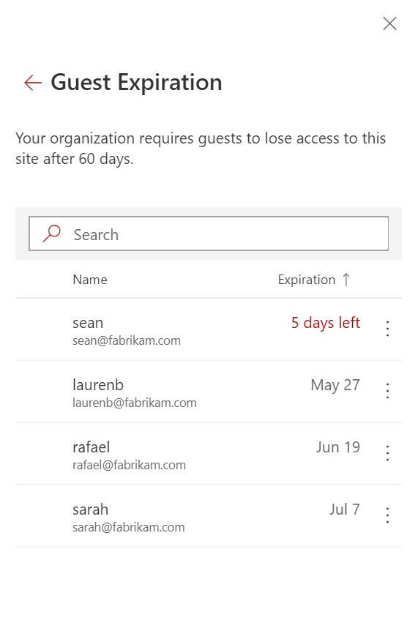

NEW! Expiring external access
Require external users to lose access to site contents
Site admins can vouch for external access and extend their expiration (up to IT policy)
Coming this year
Expires automatically after 90 days

Slide 120

NEW! Expiring external access
Require external users to lose access to site contents
Site admins can vouch for external access and extend their expiration (up to IT policy)
Coming this year
Expires automatically after 90 days
Expires automatically after 90 days

Slide 121
NEW! Expiring external access
Require external users to lose access to site contents
Site admins can vouch for external access and extend their expiration (up to IT policy)
Coming this year
Expires automatically after 90 days

Slide 122
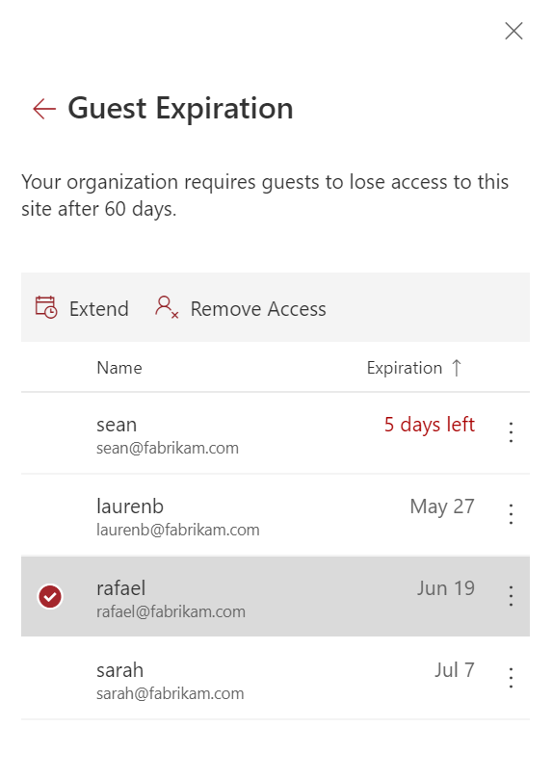
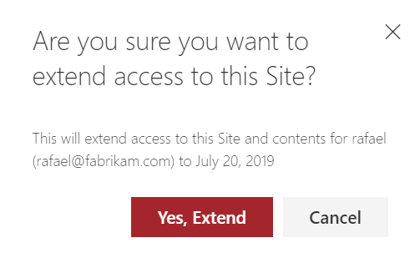
NEW! Expiring external access
Require external users to lose access to site contents
Site admins can vouch for external access and extend their expiration (up to IT policy)
Coming this year
Site admin renews Elvia's access
Extended another 90 days by site admin

Slide 123
NEW! Expiring external access
Require external users to lose access to site contents
Site admins can vouch for external access and extend their expiration (up to IT policy)
Coming this year
Extended another 90 days by site admin

Slide 124
Summary

Slide 125
What’s new for end users
What’s new for admins
Sharing integration in Microsoft Teams & Outlook
Sharing links that block download
Request files
Get link to PowerPoint slide
Reply to Office comments from Outlook
Address bar sharing
Sharing Reports
Expiring external access
Azure B2B Integration in Preview
Per-Site Anyone Link Expiration
Default Sharing Link to People with Existing Access

Slide 126
What’s new for end users
What’s new for admins
Sharing integration in Microsoft Teams & Outlook
Sharing links that block download
Request files
Get link to PowerPoint slide
Reply to Office comments from Outlook
Address bar sharing
Sync across organizations
Password protected Anyone links
External users in file View counts
Comments on all file types
Save for Later
@mentions in Office comments
Mute notifications on specific files
Popular Around Me
Inherited Links Banner in Manage Access
Sharing Reports
Expiring external access
Azure B2B Integration in Preview
Per-Site Anyone Link Expiration
Default Sharing Link to People with Existing Access
New Site Collection Sharing Settings Panel for Modern SharePoint Admin Center
Modern Site Sharing Settings Experience
Custom IT Help Link for External Sharing
Productivity Score for Admins

Slide 127
OBRIGADA!!!
You can find me:
www.sarabarbosa.net
<- LinkedIn
Twitter - >

